Slide 1



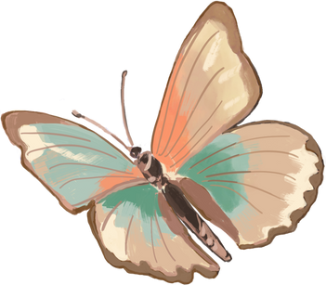


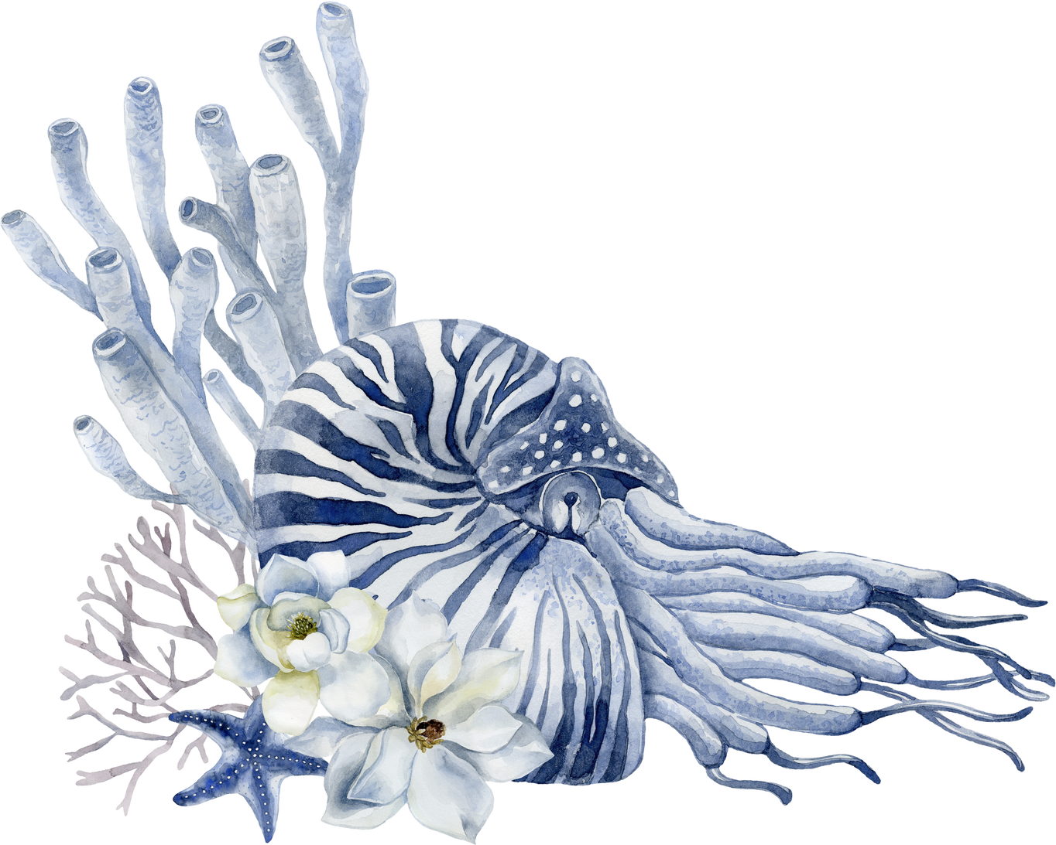
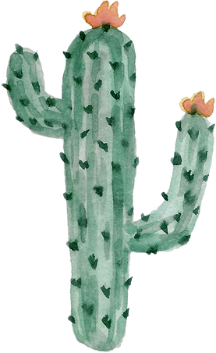
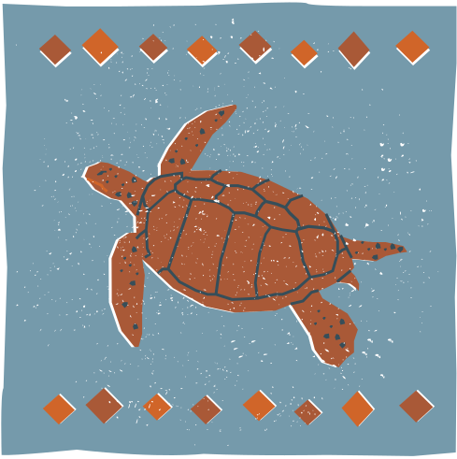
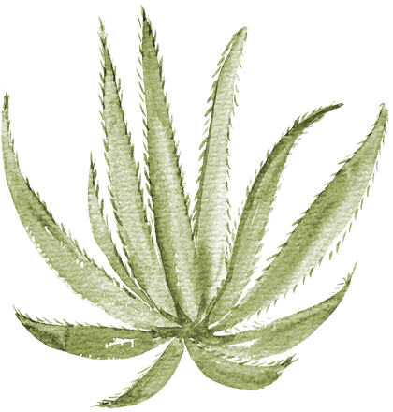
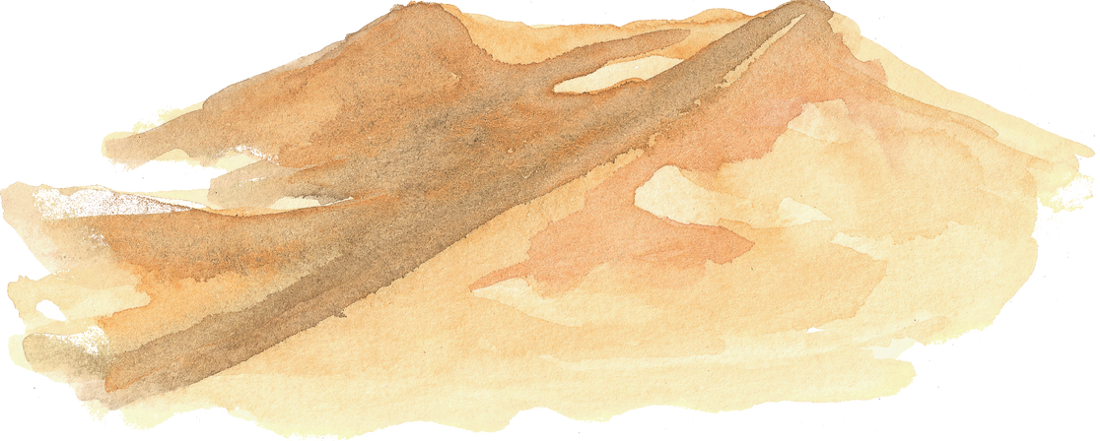
National Association of Conservation Districts Stewardship Week 2025
  stewardship@nacdnet.org

Slide 2


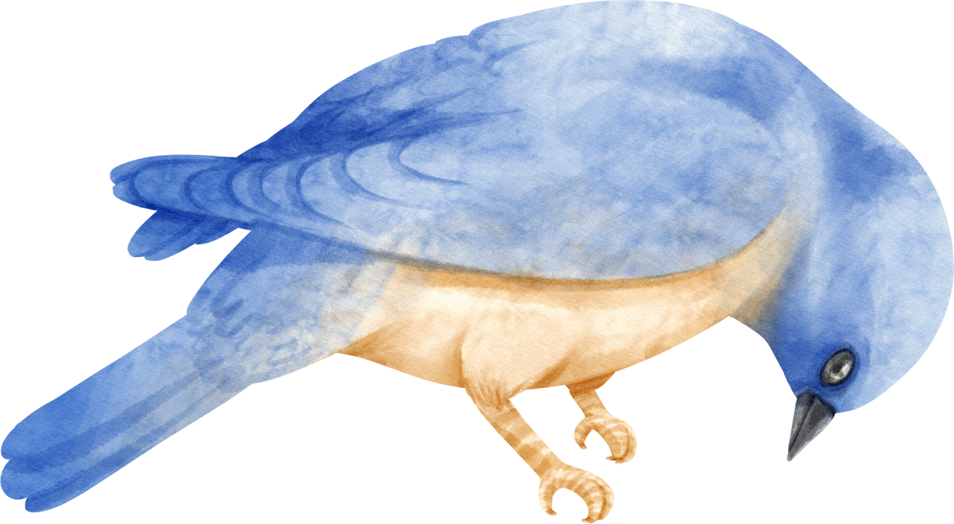
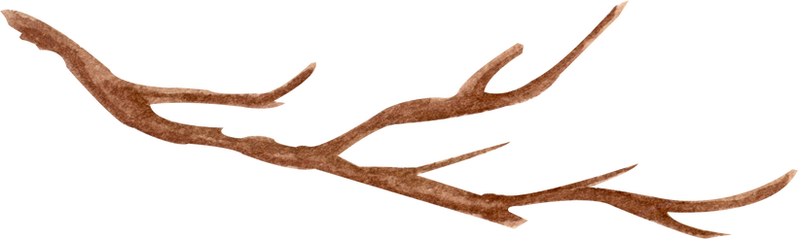
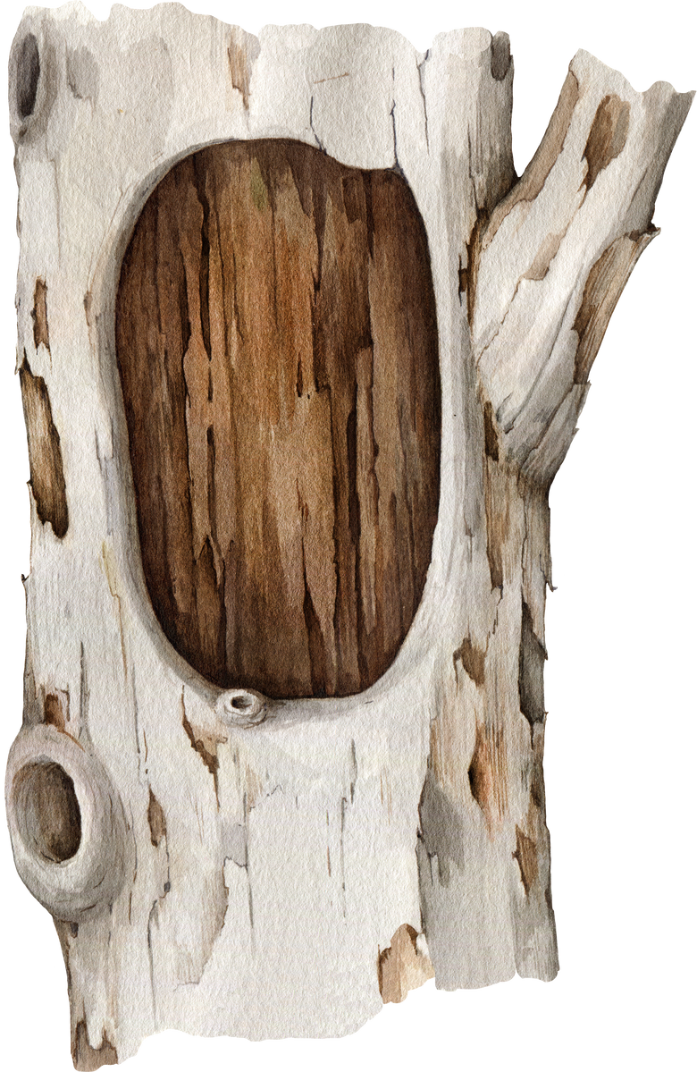
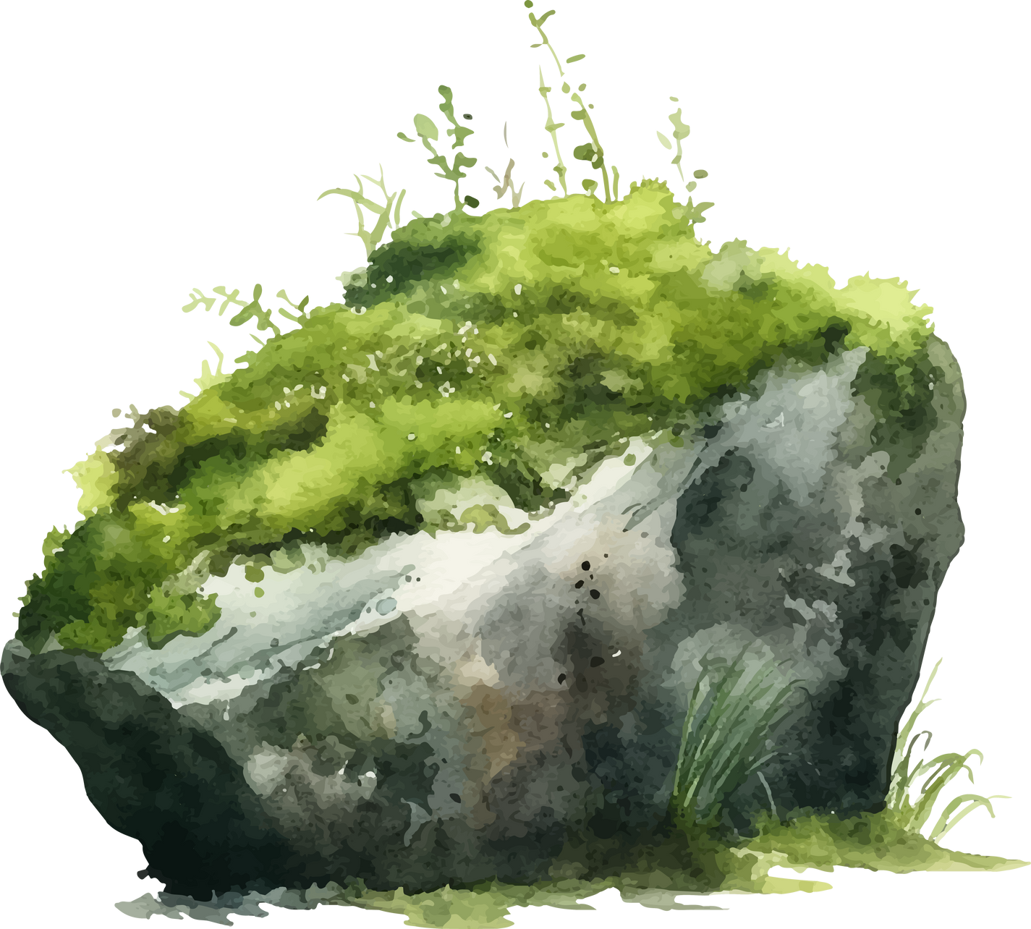
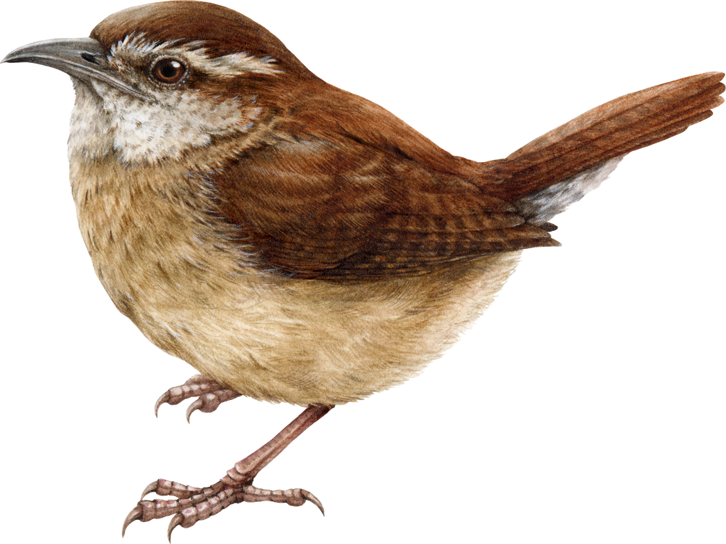
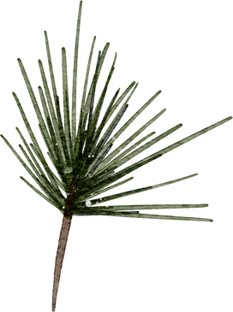
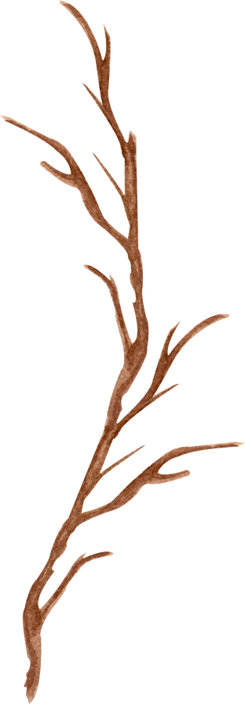
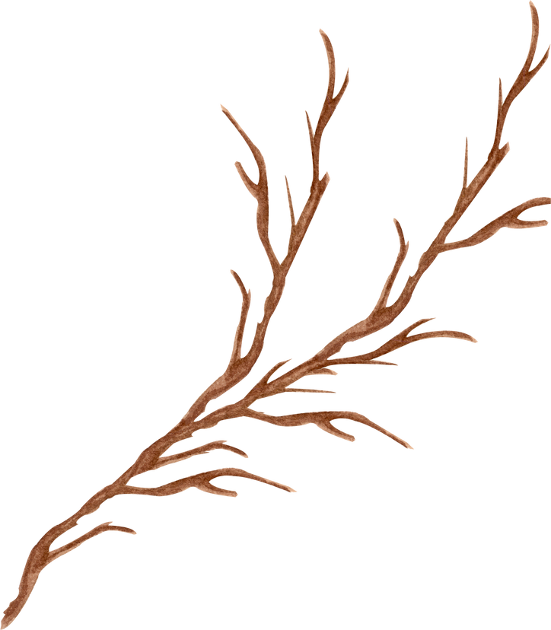
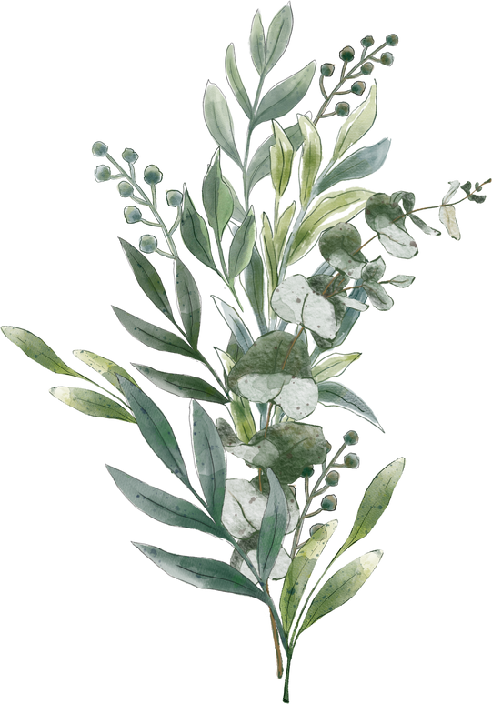
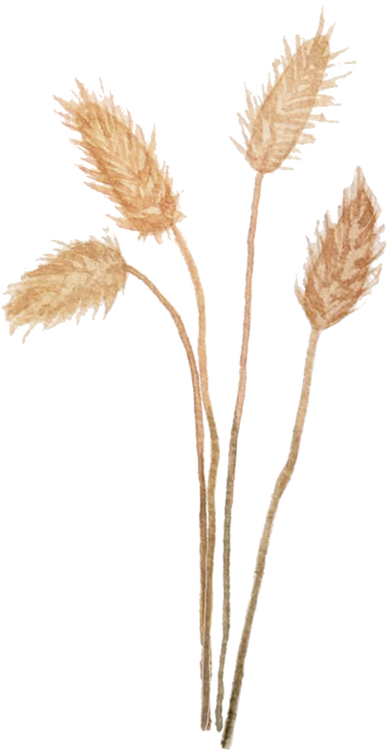

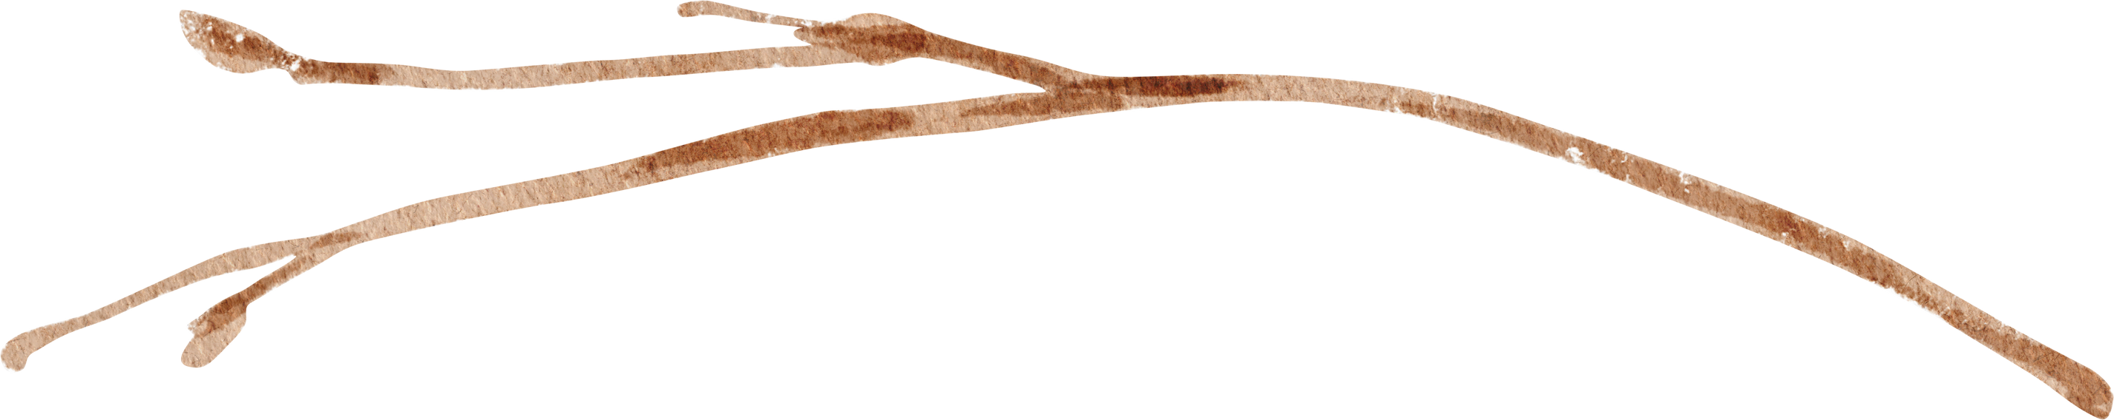
Home is where the Habitat is
The National Association of Conservation Districts Stewardship Week, an annual program since 1955, stands as one of the nation’s largest initiatives dedicated to promoting the conservation of natural resources. Occurring between the last Sunday in April and the first Sunday in May, this week-long event serves as a powerful reminder of our personal responsibilities to safeguard our precious natural resources.
The 2025 Stewardship theme “Home is Where the Habitat is.” highlights the essential role of both natural and managed habitats in our conservation efforts. Please visit www.nacdnet.org/store/ for the 2025 NACD Stewardship and Education themed branding kit and free downloads.
While Stewardship Week is a focused event, our commitment to celebrating and safeguarding these habitats extends throughout the entire year. Our conservation community is dedicated to protecting a wide range of ecosystems—from pristine natural landscapes to carefully enhanced habitats. These efforts are critical in supporting biodiversity and maintaining ecological balance.
Join us from April 27th to May 4th, 2025, for the 70th annual Golden Jubilee Anniversary, in recognizing the importance of these habitats, and our partnerships as we work together to ensure their health and resilience for future generations.

Slide 3
What are Conservation Districts?
Conservation districts, also known as soil and water conservation districts, land conservation districts, or natural resource conservation districts are local entities focused on managing and conserving natural resources at the community level. They address issues like soil erosion, water quality, and land use through various conservation practices and educational programs, working closely with landowners, farmers, and local governments to promote sustainable land management.
These districts are run by elected or appointed boards of local citizens, who oversee conservation programs tailored to their community's needs. Staff and experts provide technical support and outreach, ensuring effective and relevant conservation solutions.
Established in the early 20th century, especially during the Dust Bowl era, conservation districts emerged from the need to manage soil erosion and other environmental challenges. The Soil Conservation Act of 1935 formalized their role, and they have since expanded their focus to include a wider range of environmental issues, continuing to drive locally-led conservation efforts.

Slide 4

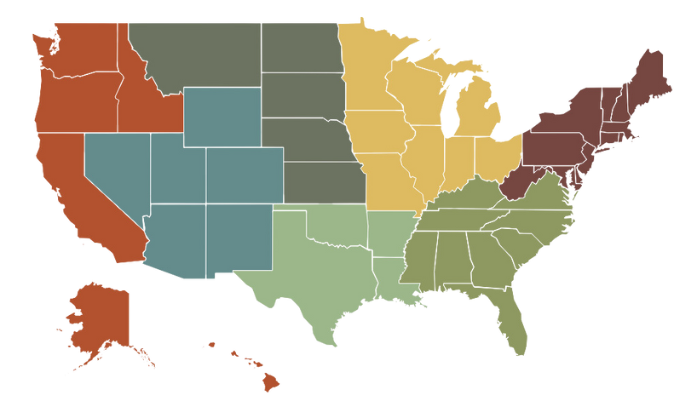
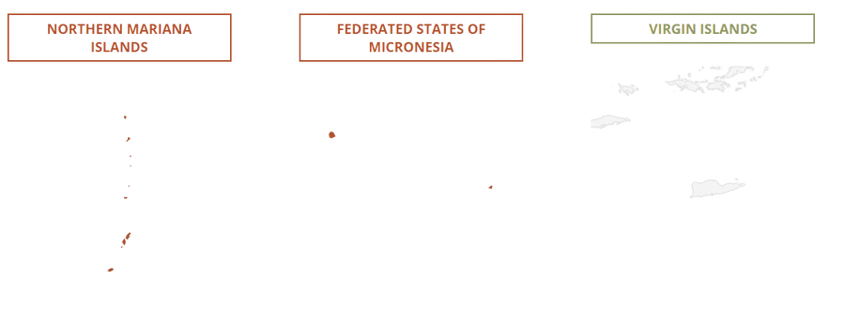
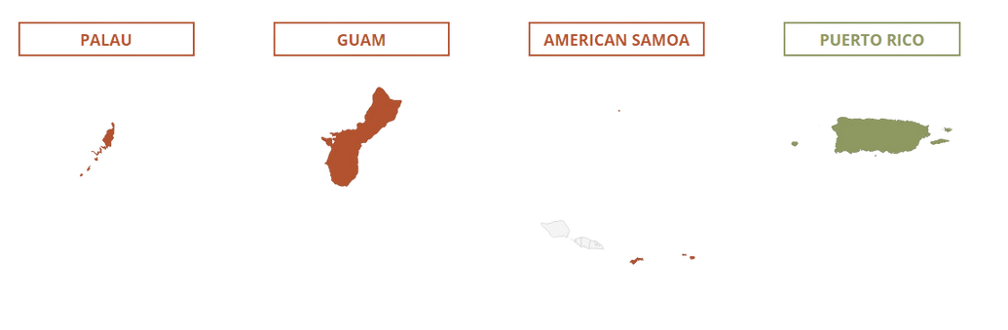
The National Association of Conservation Districts (NACD) encompasses seven regions, covering the contiguous United States, Alaska, Hawaii, and several U.S. Territories. These regions include diverse habitats and unique ecosystems, contributing significantly to the country's rich biodiversity.
NORTHEAST
Connecticut, Delaware, Maine, Maryland, Massachusetts, New Hampshire, New Jersey, New York, Pennsylvania, Rhode Island, Vermont, West Virginia
SOUTHEAST
Alabama, Florida, Georgia, Kentucky, Mississippi, North Carolina, South Carolina, Tennessee, Virginia, Puerto Rico, U.S. Virgin Islands
NORTH CENTRAL
Illinois, Indiana, Iowa, Michigan, Minnesota, Missouri, Ohio, Wisconsin
SOUTH CENTRAL
Arkansas, Louisiana, Oklahoma, Texas
NORTHERN PLAINS
Kansas, Montana, Nebraska, North Dakota, South Dakota
SOUTHWEST
Arizona, Colorado, Nevada, New Mexico, Utah, Wyoming
PACIFIC
Alaska, California, Hawaii, Idaho, Oregon, Washington, American Samoa, Guam, Northern Mariana Islands

Slide 5

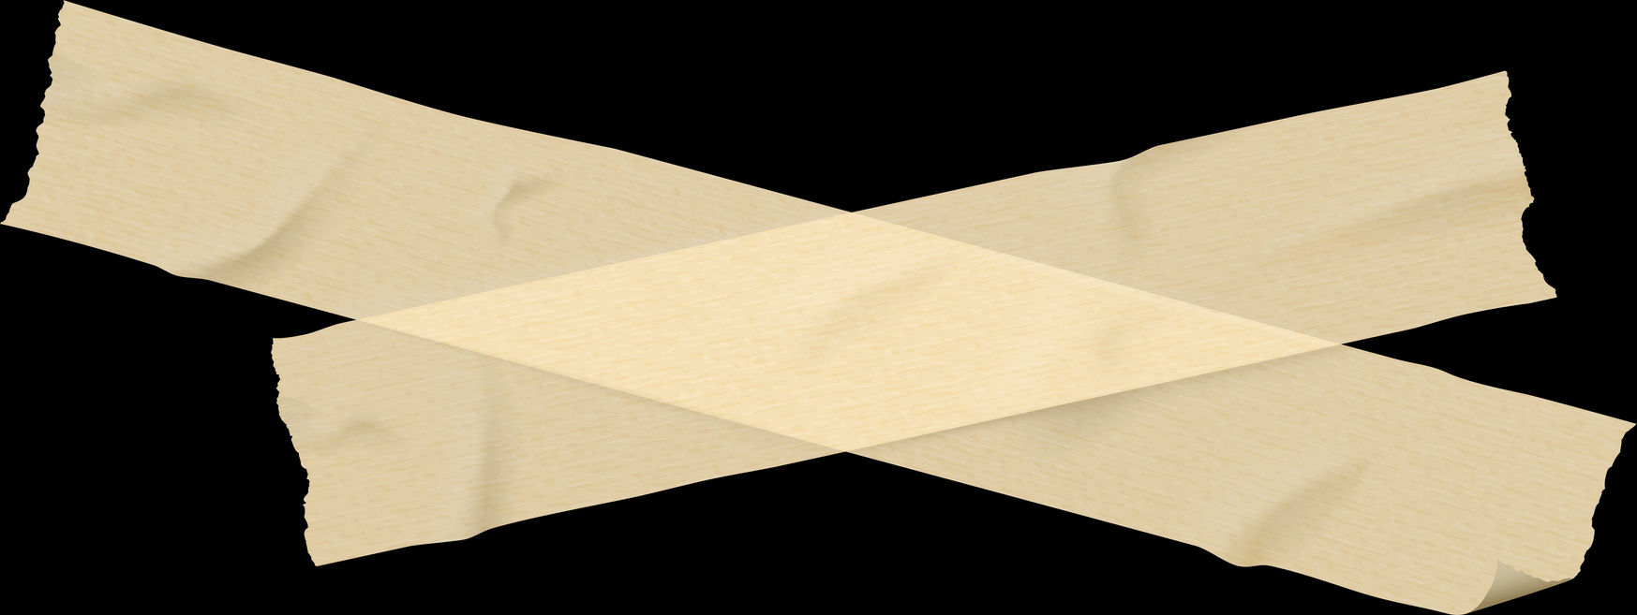




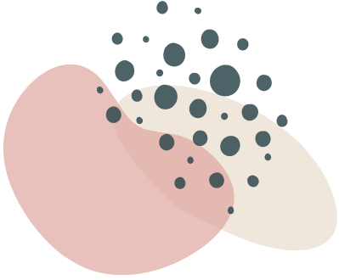


Biomes, Ecosystems and Habitats, oh my!
To understand diverse habitats, it’s essential to first grasp their broader contexts in the ecological hierarchy.
At the top is the biosphere (or ecosphere), encompassing all life on Earth and their interactions with the environment. Within this, biomes are large-scale environments defined by climate and vegetation.
For instance, in a tropical rainforest biome, you find various ecosystems such as the forest floor, canopy, and riverbanks. Each of these ecosystems supports specific habitats with unique conditions and resources.
By understanding the biosphere and its biomes, you gain insight into the ecosystems and habitats within, highlighting how the larger context shapes the specific environments where organisms live and thrive.
Okay, we admit, you might not be familiar with this classic film reference, but if you are, you might just imagine visiting the wondrous Biome of OZ!
Or was Oz a habitat?
Either way, the next two slides will explain the difference in a biome and a habitat.
Biome: A large geographical area characterized by its climate, vegetation, and animal life. It is determined by the interaction of temperature, precipitation, and altitude, which influence the types of plants and animals that can thrive there.
Habitat: Refers to the specific environment where an organism lives. It includes both biotic (living) and abiotic (non-living) factors that define the conditions of the area. Habitats can vary in size, from a small rock pool to a large forest.
Image Credit: Image of Dorothy and Toto from The Wizard of Oz (1939). © Warner Bros. Used under Fair Use for educational purposes.

Slide 6
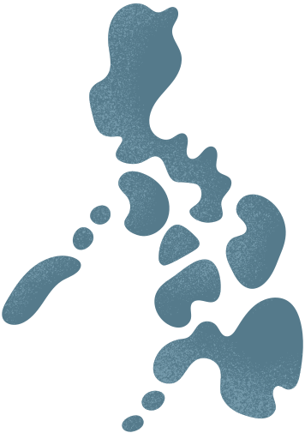

Habitats vs. Biomes: A Comparative Overview
SCALE
Habitat: Typically smaller in scale, habitats are specific places where individual species or communities of organisms live within a biome.
Biome: Larger in scale, biomes encompass multiple habitats and are defined by broader climate patterns and geographical features.
RELATIONSHIP
Habitat within Biome: Within a biome, various habitats can exist. For example, within a tropical rainforest biome, habitats can include forest floors, canopy layers, rivers, and wetlands.
Biome Classification: Biomes are classified based on similar climate conditions and dominant vegetation. The number of biomes can vary depending on the classification system used, but commonly, there are about 12 major biomes recognized in ecological studies. Examples include deserts, grasslands, tundra, and temperate forests.
HIERARCHY
Primary Concept: Habitats are the primary concept, as they refer to the specific living conditions where organisms are found.
Secondary Concept: Biomes are a secondary concept that categorizes habitats into larger, more generalized geographic regions based on climate and vegetation patterns.
  ASPECT
  HABITAT
  BIOMES
Specific environment where organisms live
Large geographical areas with similar climate and vegetation
DEFINITION
SCALE
Small (e.g., pond, forest floor)
Large (e.g., tropical rainforest, desert)
COMPONENTS
Biotic and abiotic factors
Climate, vegetation, animal life
EXAMPLES
Coral reefs, grasslands, rivers
Tropical rainforest, tundra, desert
HIERACHY IN SCIENCE
Primary concept
Secondary concept
Download the biome and habitat worksheet at nacdnet.org/store

Slide 7

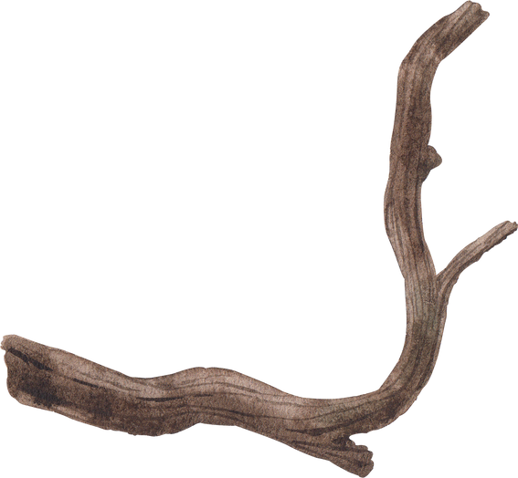
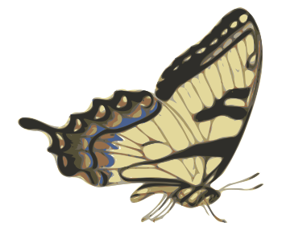


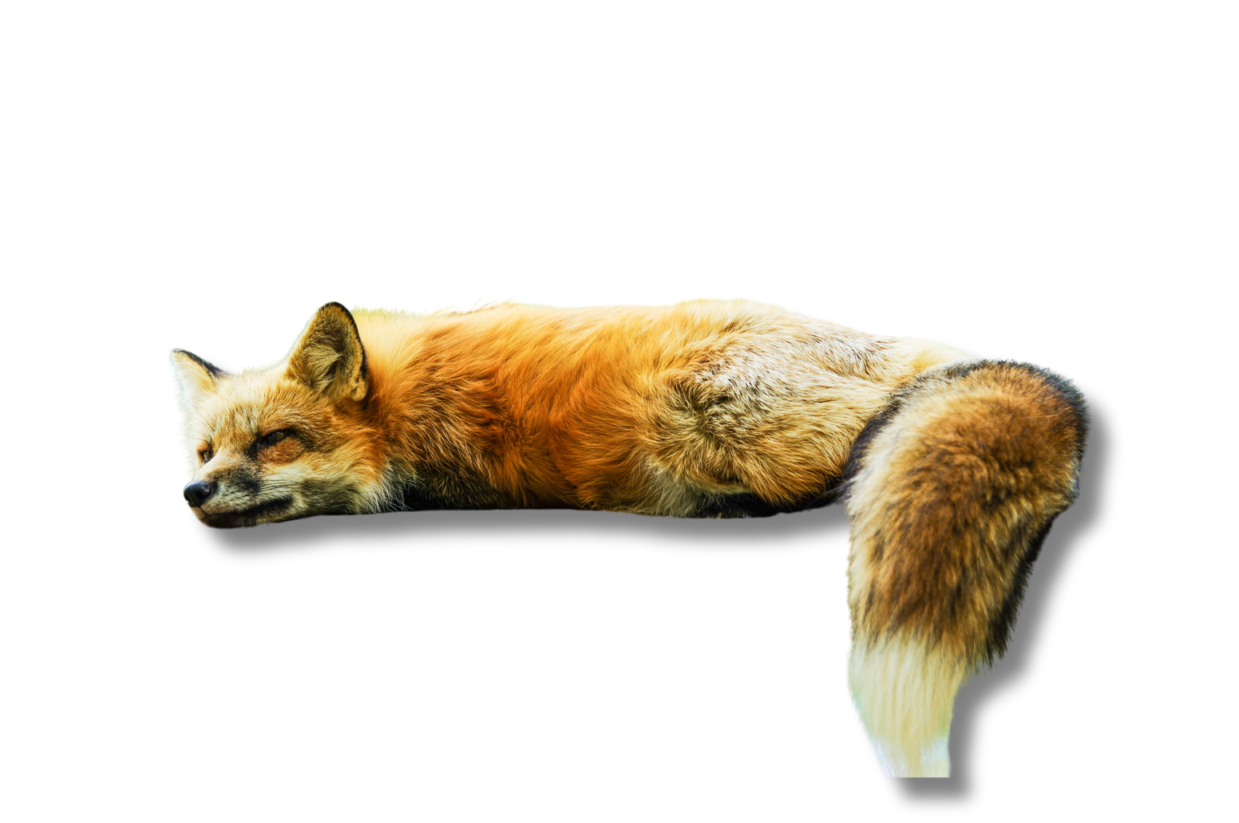

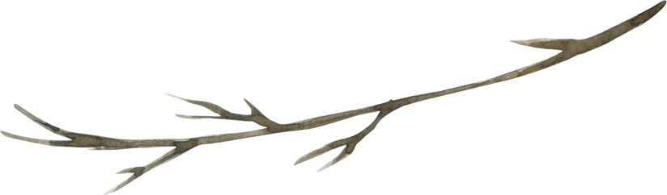

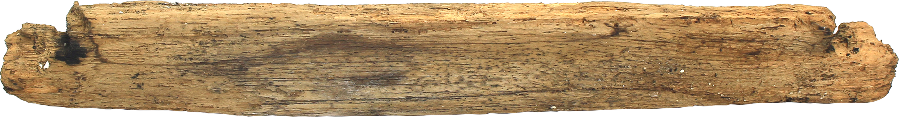
Word of the Day!
SIMPLY STATED
“Shared habitat, but I’m staying up high for safety!”
HABITAT
hab·​i·​tat ˈha-bə-ˌtat
1: a: the place or environment here a plant or animal naturally or normally lives and grows
b: the typical place of residence of a person or a group.
c: a housing for a controlled physical environment in which people can live under surrounding inhospitable conditions.
These habitats are engineered to provide essential life-support systems such as air, water, and temperature regulation, allowing people to function in environments where natural conditions would be unsuitable for human habitation.
2: The place where something is commonly found.
“HOME IS WHERE WHERE THE HABITAT IS”
Word of the day definition source:
merriam-webster.com

Slide 8

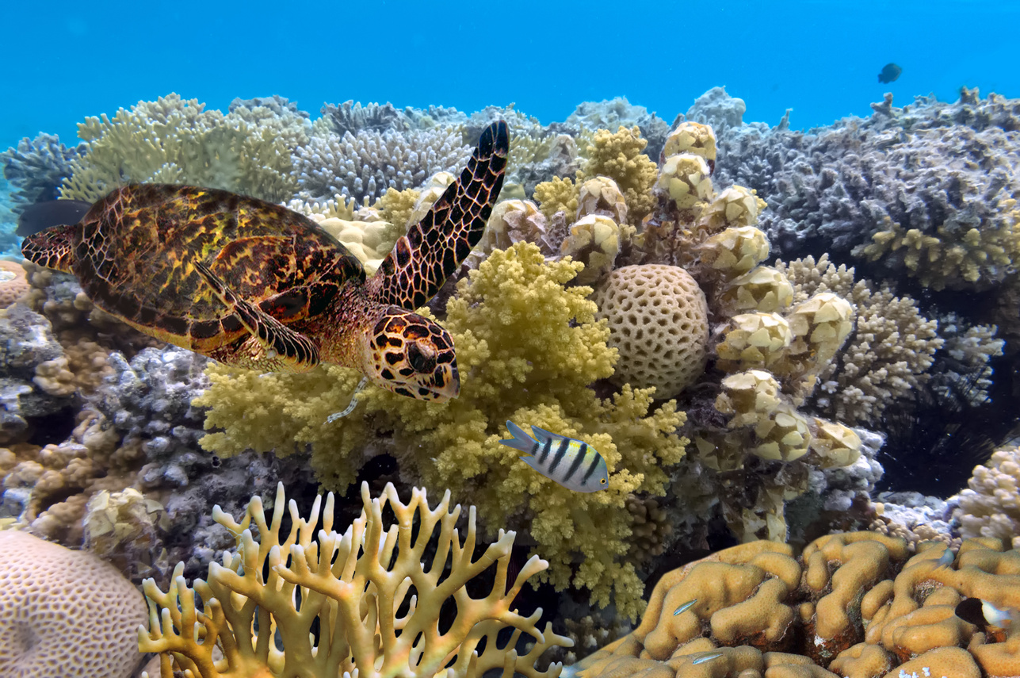
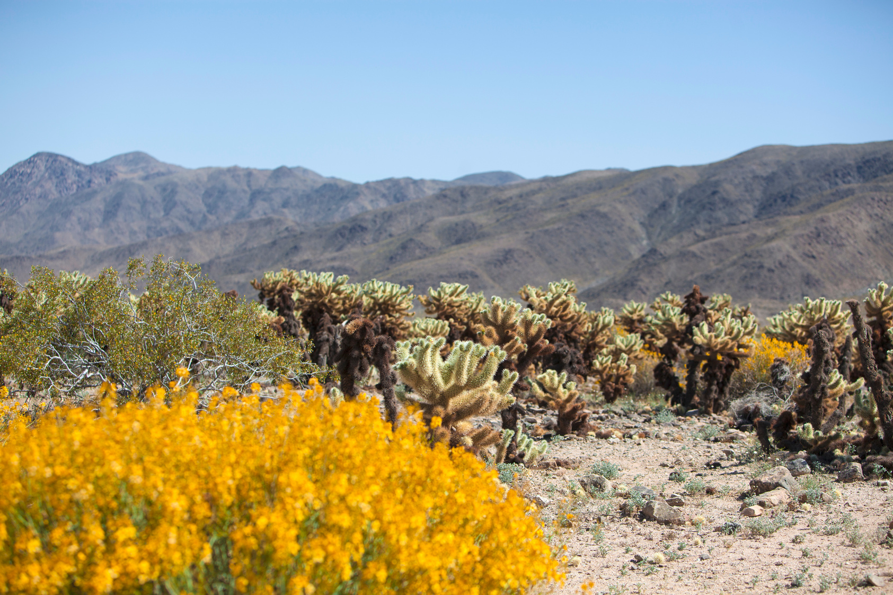
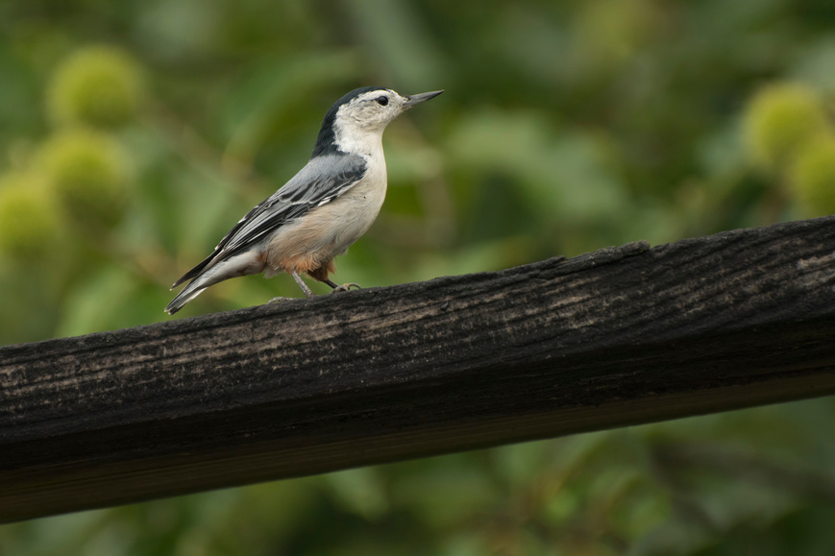
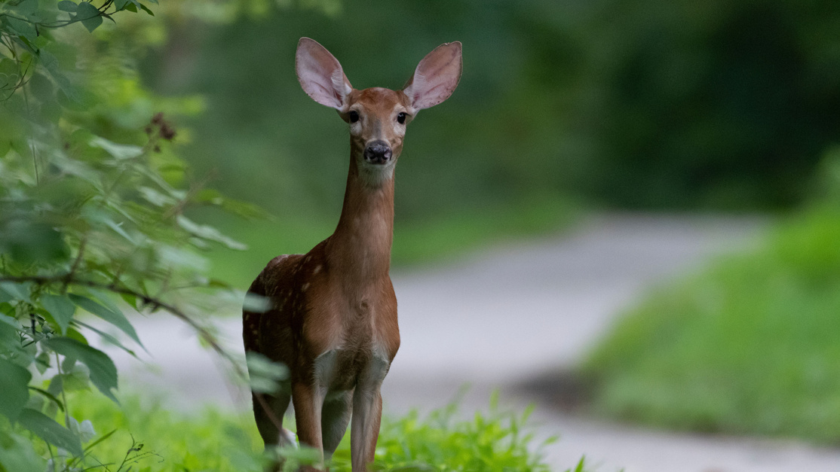
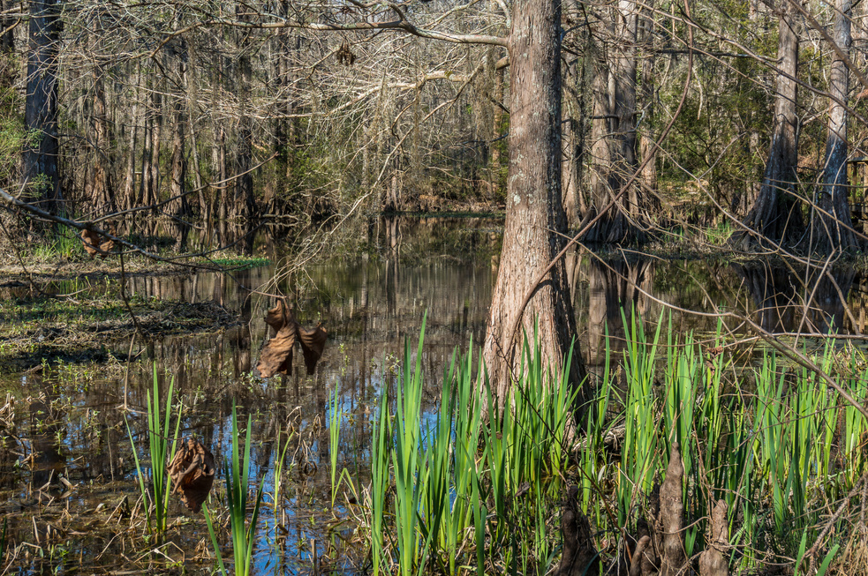
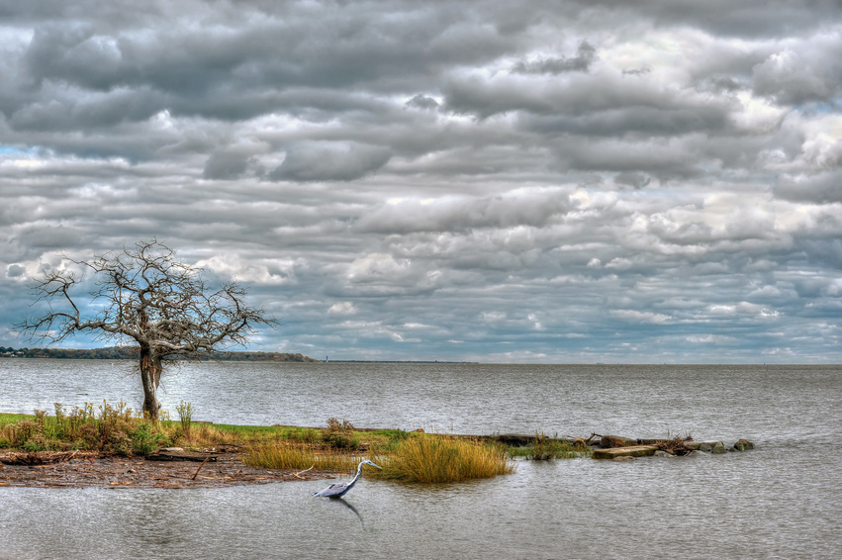
THERE ARE TWO BROAD HABITAT CATEGORIES:
AQUATIC and TERRESTRIAL
Aquatic habitats are found in water, like oceans and lakes, while terrestrial habitats are on land, like forests and deserts. Each has unique features that support different kinds of life.
AQUATIC
TERRESTRIAL

Slide 9



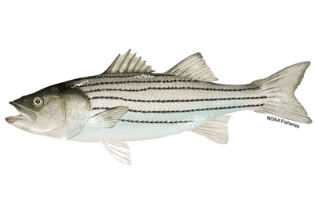

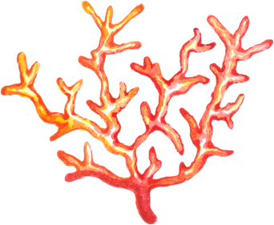
AQUATIC HABITATS
Aquatic Habitat Restoration
Success Story
The Chesapeake Bay, the largest U.S. estuary, faced severe degradation due to pollution and habitat destruction.
The Anne Arundel Soil Conservation District, in collaboration with the Chesapeake Bay Foundation, led a restoration project to improve water quality and restore habitats.
KEY ACTIONS:
Planting riparian buffers
Re-establishing wetlands
Constructing oyster reefs
Restoring stream channels
These efforts significantly reduced pollution, improved water quality, and revitalized habitats for fish, crabs, and birds. This project highlights the impact of collaborative conservation efforts and serves as a model for aquatic habitat restoration.
  In the contenential U.S., we have many important aquatic habitats, such as the Great Lakes, the Gulf of Mexico, and the coastal waters of Alaska. U.S. territories include unique aquatic environments like the coral reefs of Guam and the mangroves of Puerto Rico. These habitats vary in temperature, salinity, and depth, creating diverse environments for plants and animals across the mainland and territories.
Striped bass, more commonly called ‘rockfish’ or ‘stripers,’ are perhaps the most iconic fish in the Chesapeake Bay region. Distinguished by the dark horizontal stripes on their silver bodies, rockfish can live up to 30 years and reach over five feet in length. They migrate up and down the East Coast, but most are born in the Chesapeake Bay and its tributaries and play an important role as a top predator in the Bay ecosystem. They are prized by recreational anglers and commercial fishermen alike. 2022 stock assessment found that the striped bass population along the Atlantic Coast is no longer experiencing overfishing, but numbers remain below the management threshold, indicating further rebuilding of the population is required
SOURCE: cbf.org
For more information on Chesapeake Bay restoration efforts:

Slide 10
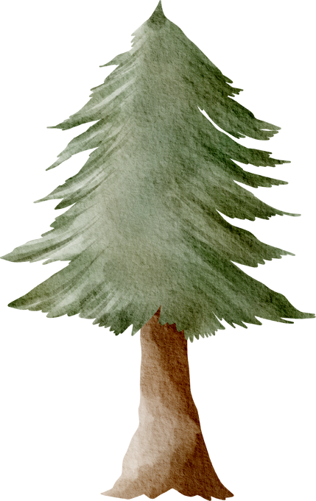
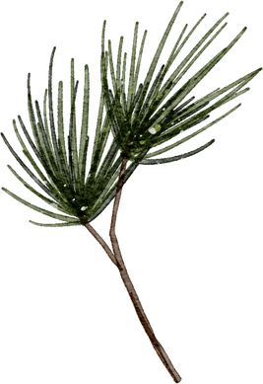
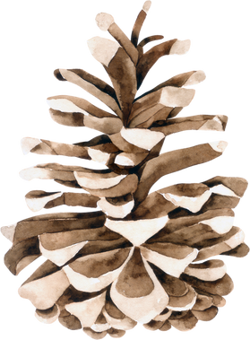
Terristrial Habitat Restoration Success Story
Terrestrial Habitats
The restoration of the Longleaf Pine ecosystem in the southeastern U.S. is a notable success story. Once covering millions of acres, this habitat was severely diminished by land use changes.
Conservation efforts, including replanting longleaf pines and reintroducing prescribed burns, have expanded the forest to about 4.5 million acres.
This recovery has revitalized the ecosystem, benefiting species such as the red-cockaded woodpecker and the gopher tortoise, and restored important ecological functions.
This project highlights the impact of dedicated habitat restoration and collaborative government and non government agencies in conservation efforts.
In the continental U.S., we have many important terrestrial habitats, such as the arid deserts of the Southwest and the lush Appalachian Mountains.
In Alaska, the expansive taiga and alpine tundra offer unique environments for wildlife.
U.S. territories include distinctive terrestrial landscapes like the unique dry forests of Guam and the rich volcanic soil of the Big Island in Hawaii.
  These habitats vary widely in climate, vegetation, and elevation, creating diverse environments for plants and animals across the mainland and territories.
Sources:
USDA NRCS
North Carolina Association of Soil and Water Conservation Districts
Georgia Soil and Water Conservation Commission
Florida Soil and Water Conservation Districts
U.S. Forest Service
The Longleaf Alliance
The Nature Conservancy
National Wildlife Federation

Slide 11


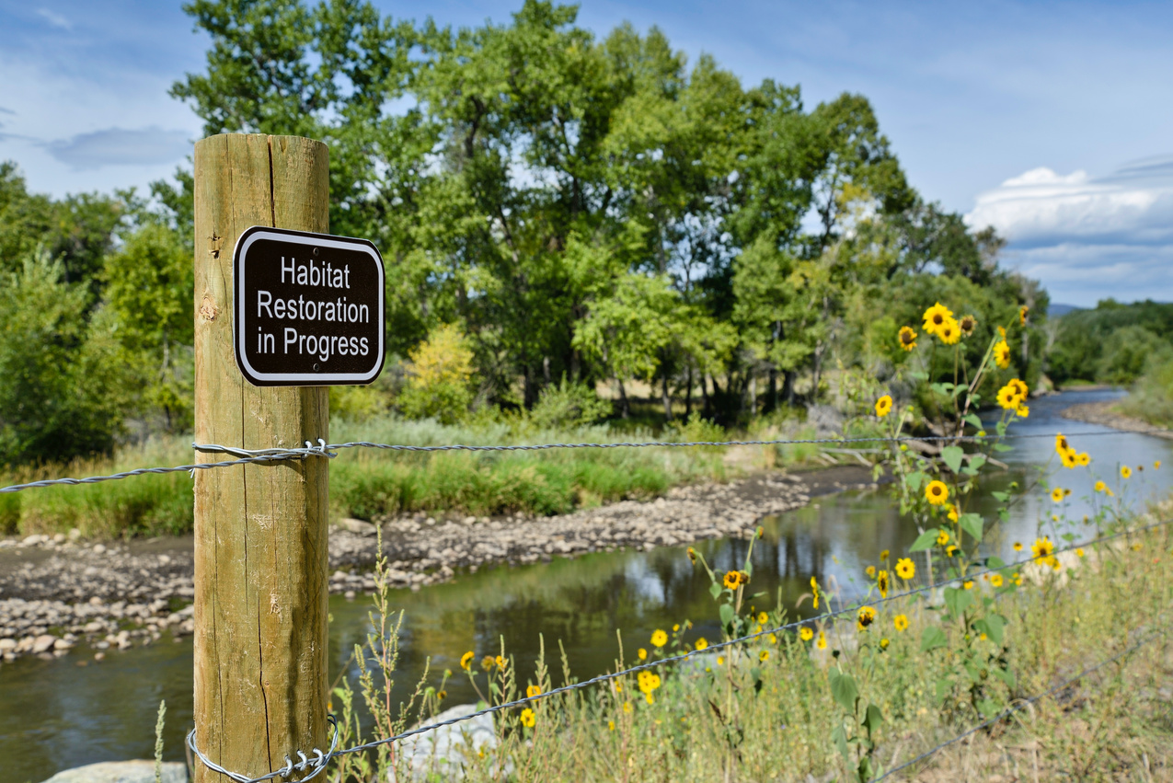


Changing Over Time
Both aquatic and terrestrial habitats undergo changes over time due to natural processes and human activities. Aquatic environments, such as rivers and oceans, can be influenced by factors like pollution, shifting water levels and the presence of new species. Similarly, terrestrial habitats are affected by changes in land use, and the introduction of non-native and invasive plant and animal species.
Understanding these changes is important, and educating our youth about them is key to ensuring effective management and preservation of our ecosystems in the future.
  Natural Resource Conservation protects and revitalizes habitats!
YOUR LOCAL CONSERVATIONISTS WORK WITH MANY PARTERNING AGENCIES TO RESTORE AND MAINTAIN NATURAL HABITATS.

Slide 12

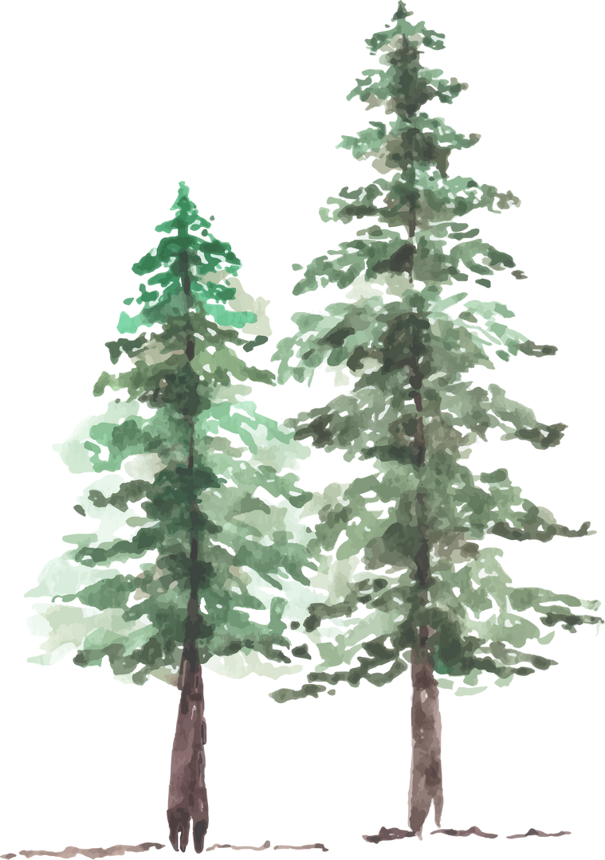

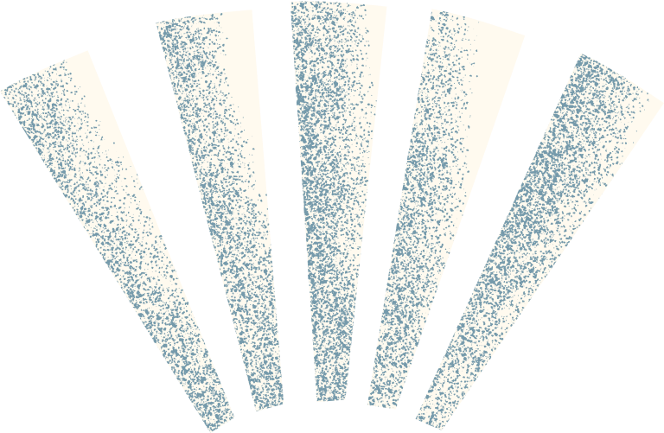
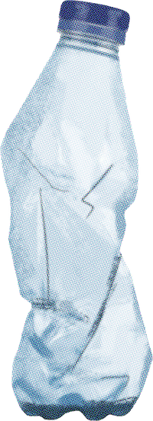
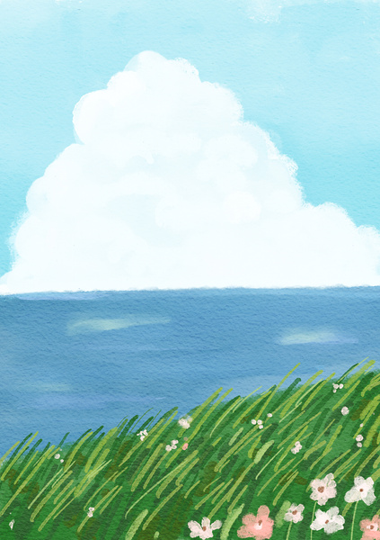
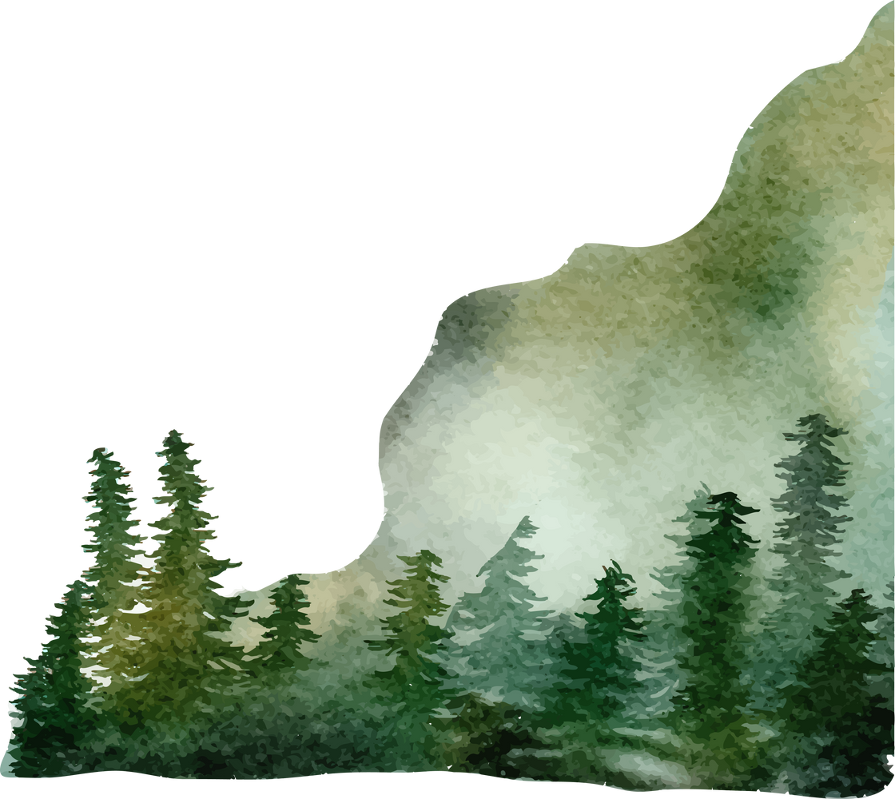
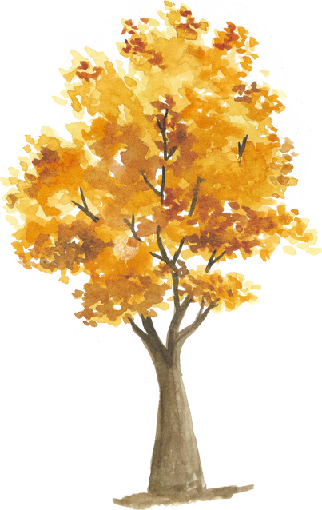

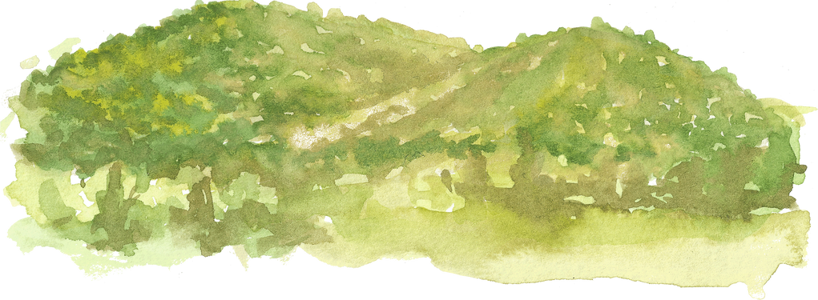
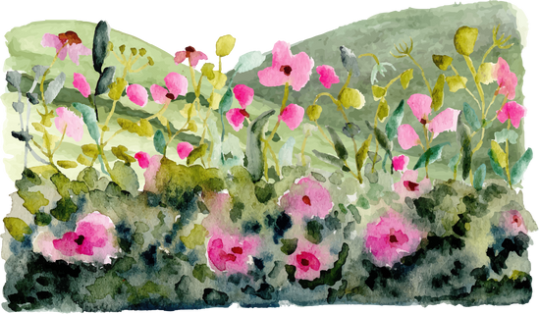
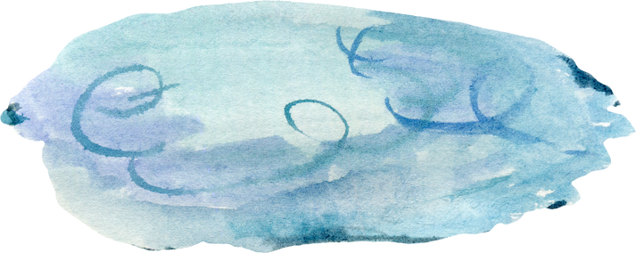
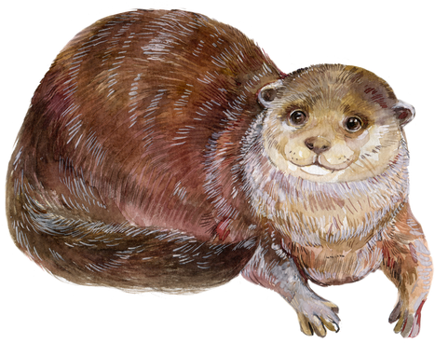

Unfortunately, natural processes and human activities are causing changes in environments at an unprecedented and accelerated rate.
Here are ways you can help!
Reduce Single-Use Plastics
Refillable water bottles, resusable bags, and containers help to minimize plastic waste that can end up in oceans and rivers.
Spread the Message
Participate in Tree Planting
Join or organize tree planting activities to help restore and expand natural habitats.
Green Spaces
  Support and advocate for the preservation of local parks and natural areas to maintain healthy terrestrial and aquatic habitats.
Raise awareness about the importance of keeping waterways clean and the effects of pollution on aquatic life
HOME is WHERE the HABITAT is
The NACD Poster and Photo contests are a great way to help spread the mesage about natural resource conservation in your community and beyond!

Slide 13


Do you have a successful habitat restoration project? We would love to hear more about it!
Share it with us at info@nacdnet.org
Subject line: Habitat Project Success Story
Sign up for eResource to discover the latest updates from your local conservation districts!
https://www.nacdnet.org/news-and-events/publications/eresource/

