Slide 1

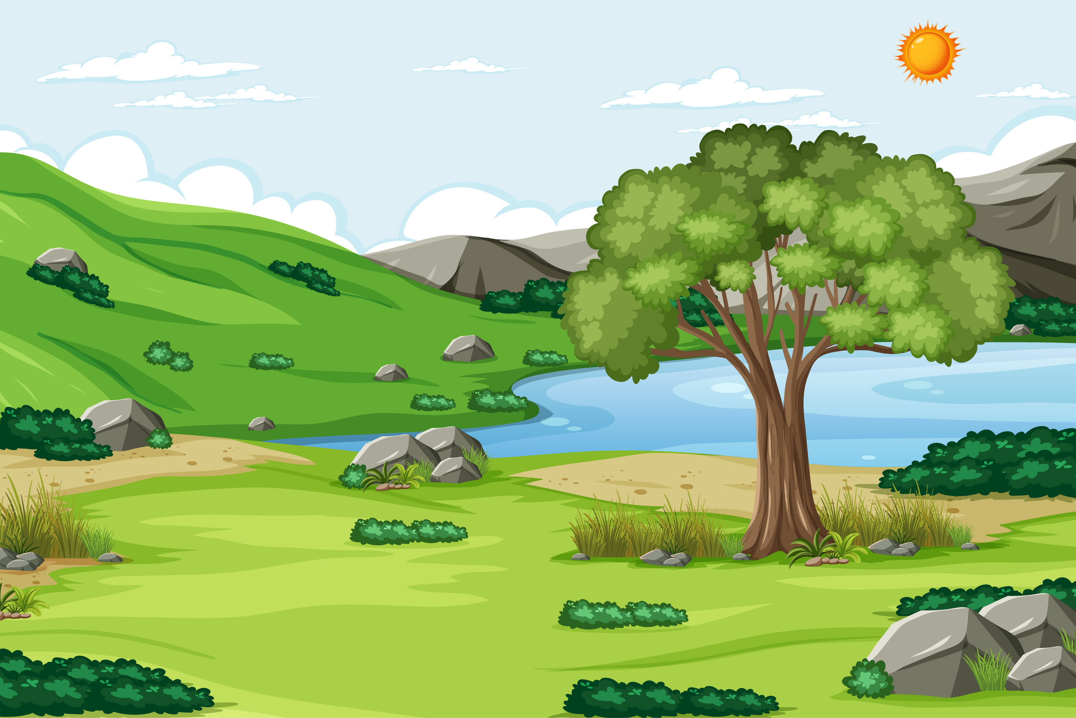


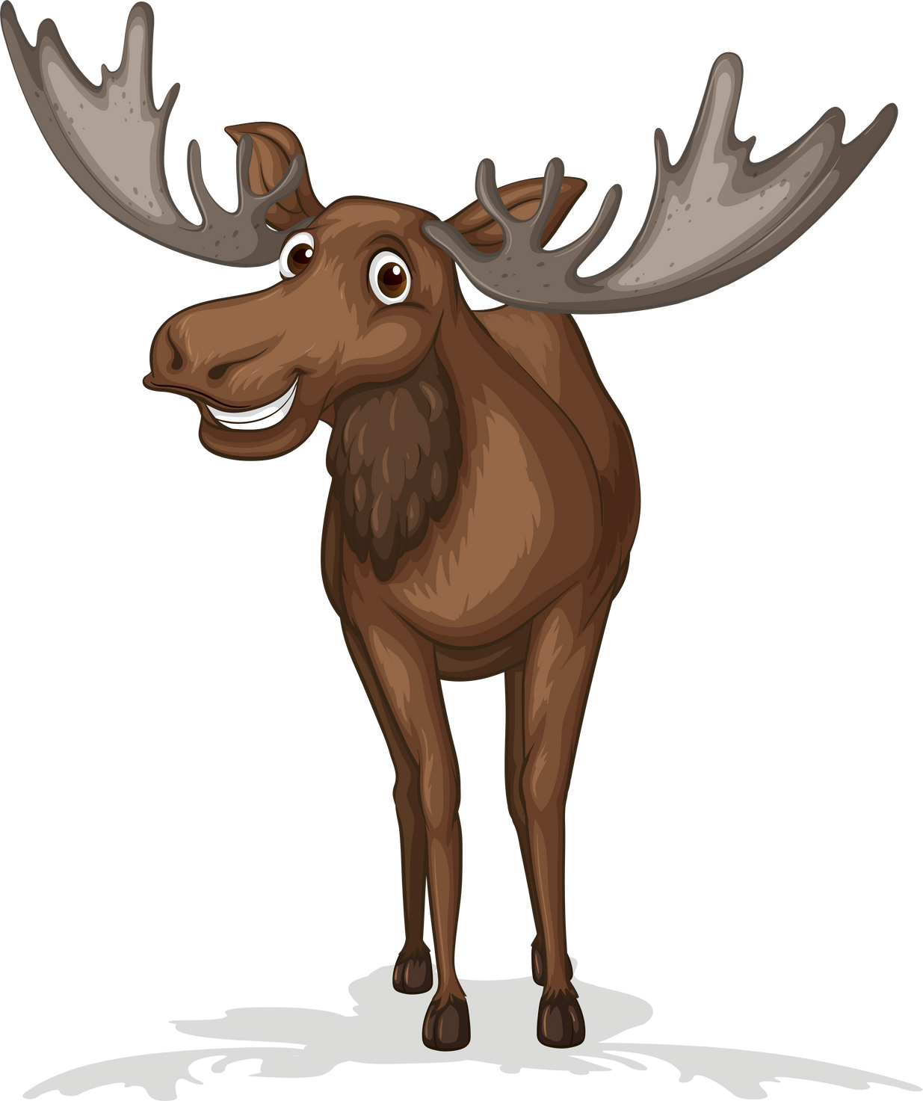




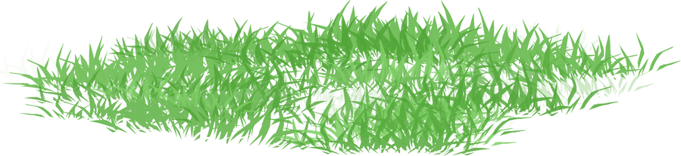
Forest
Habitats
For Primary Classrooms
National Association of Conservation Districts
2024 Stewardship Week
May the Forest be with you, Always!

Slide 2
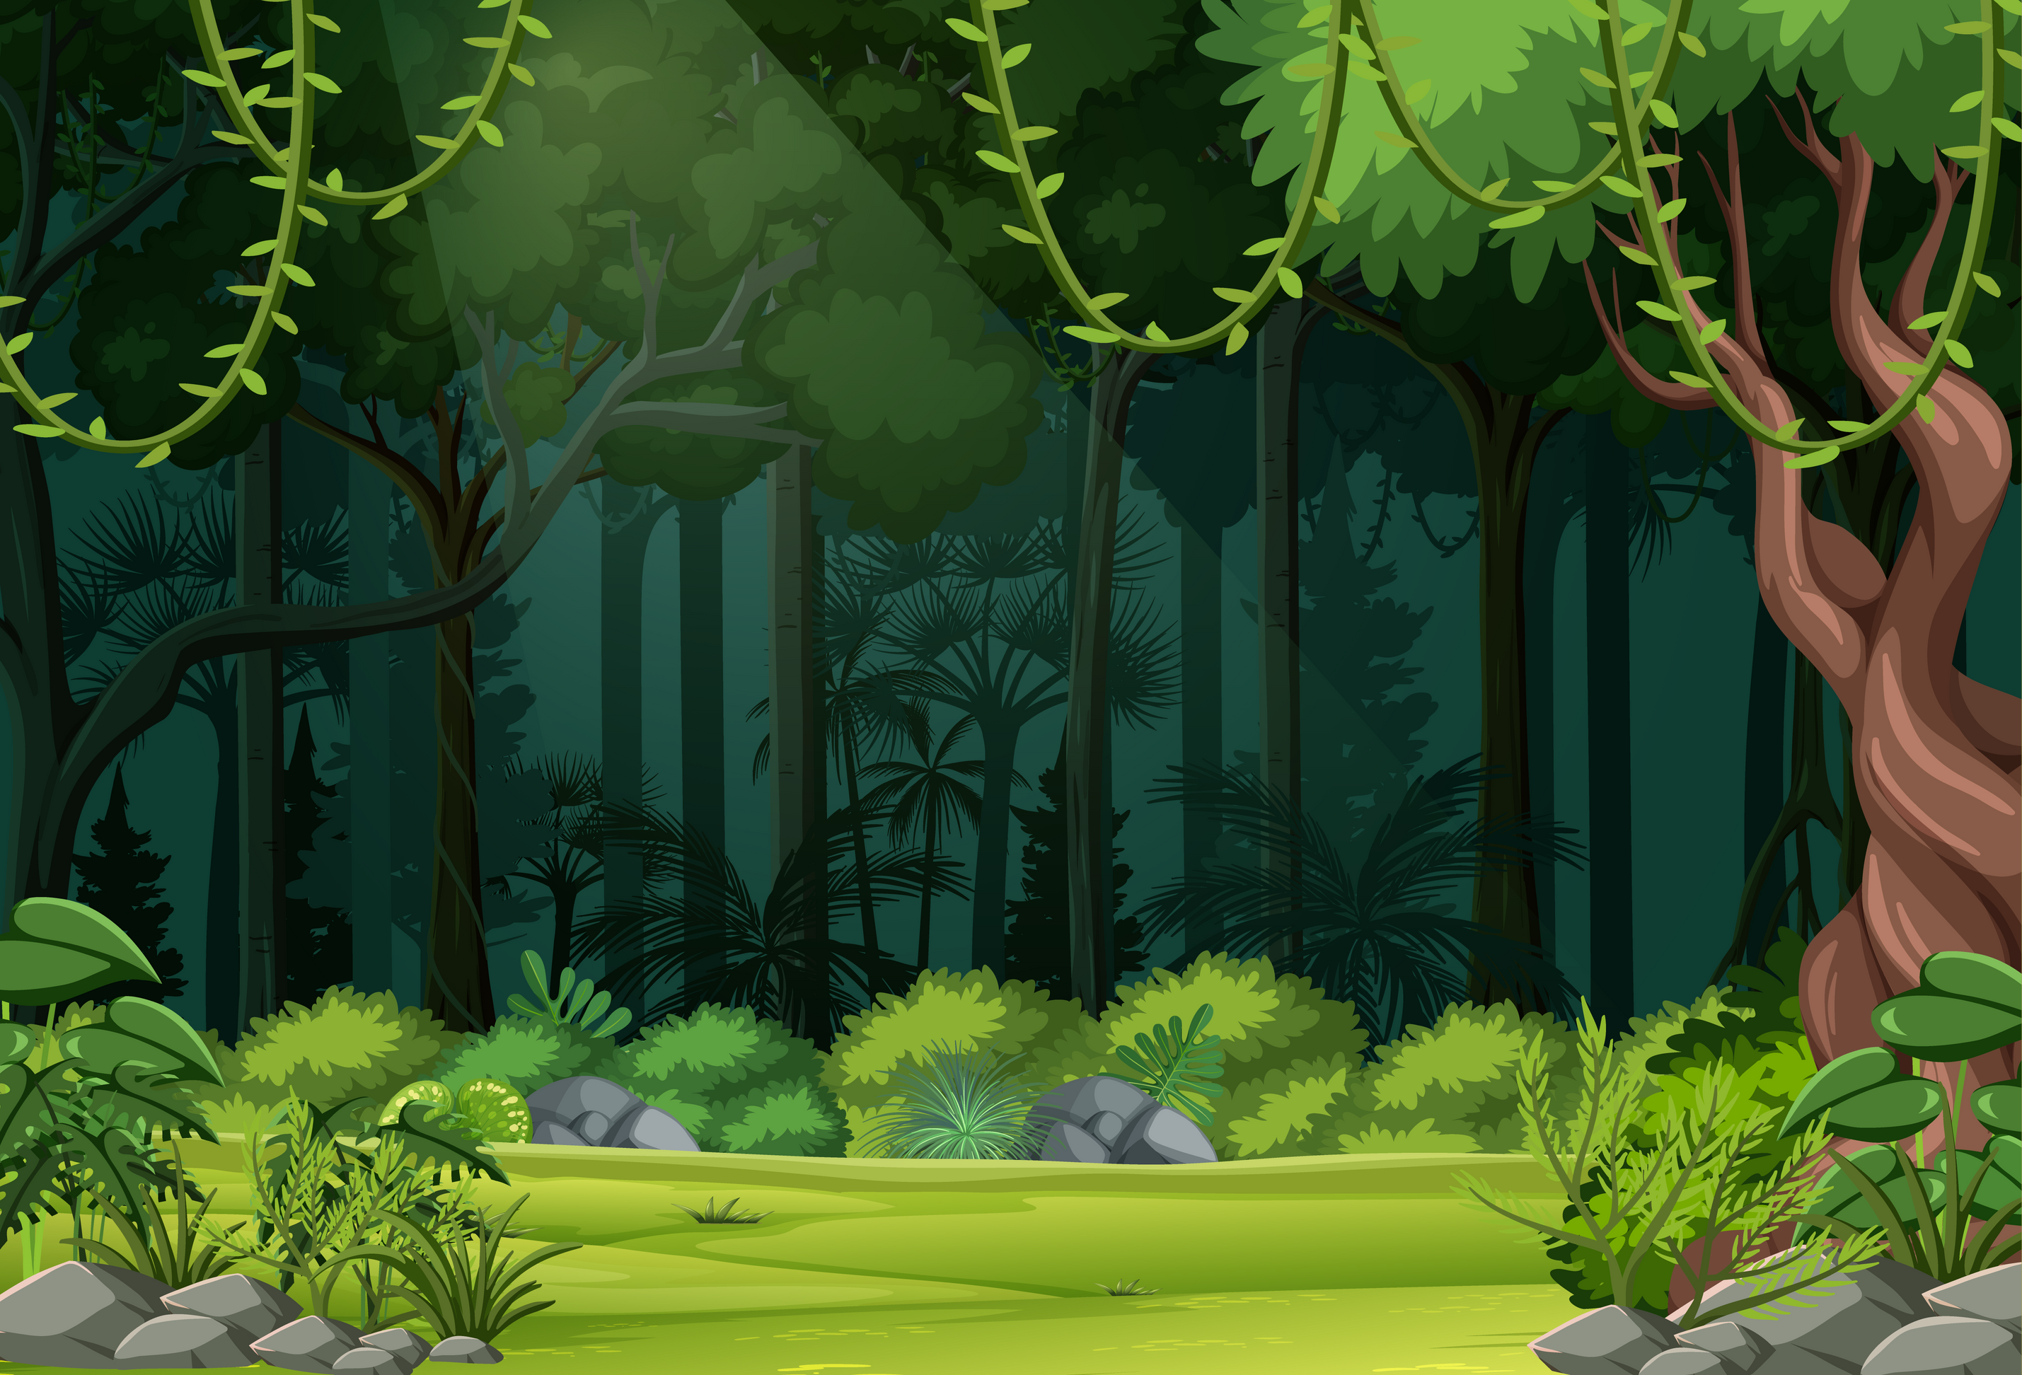



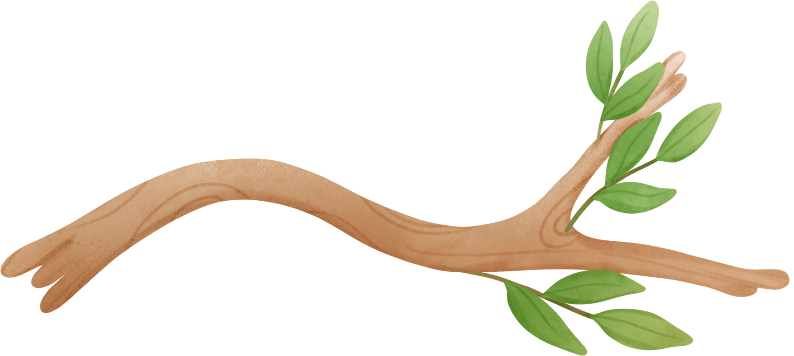



This presentation is provided by the National Association of Conservation Districts
Please ensure that the provided presentation and accompanying lesson plan are used in conjunction with each other, respecting the intended context and content.
This presentation is intended for use by Conservation Districts and their education partners.
Others should kindly seek permission before using, duplicating or modifying this presentation.
For permission to use, just email us! stewardship@nacdnet.org

Slide 3
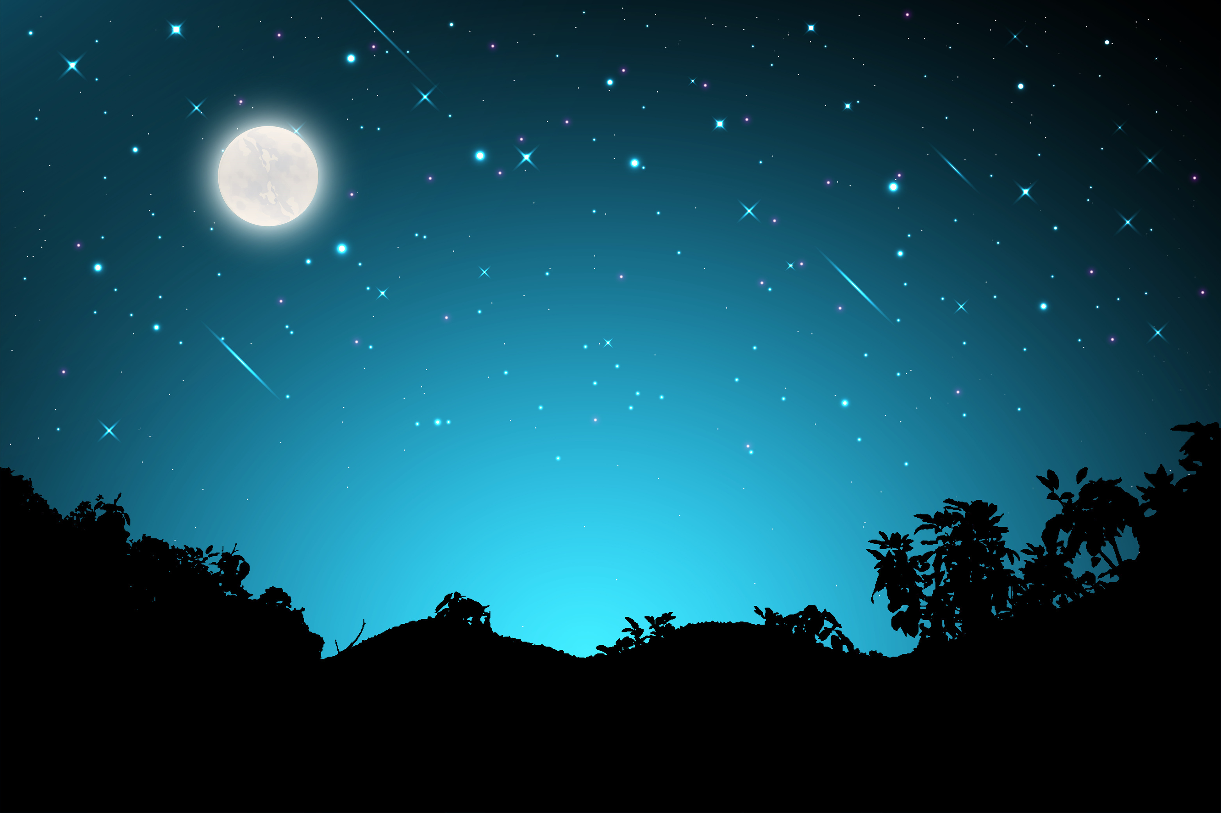



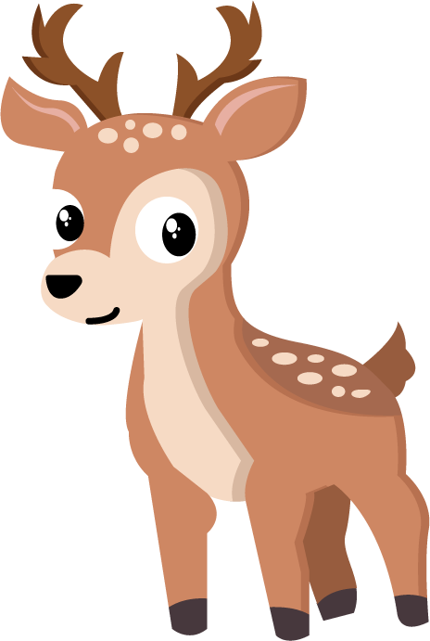

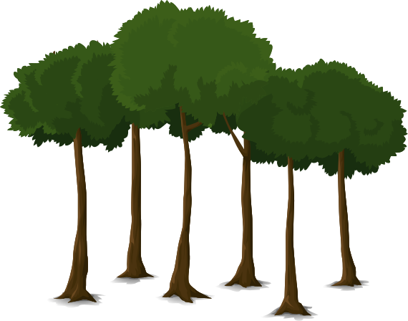

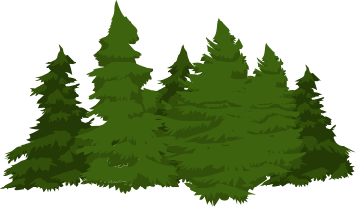






Hi!
Welcome to
the Forest!
This is our HABITAT

Slide 4
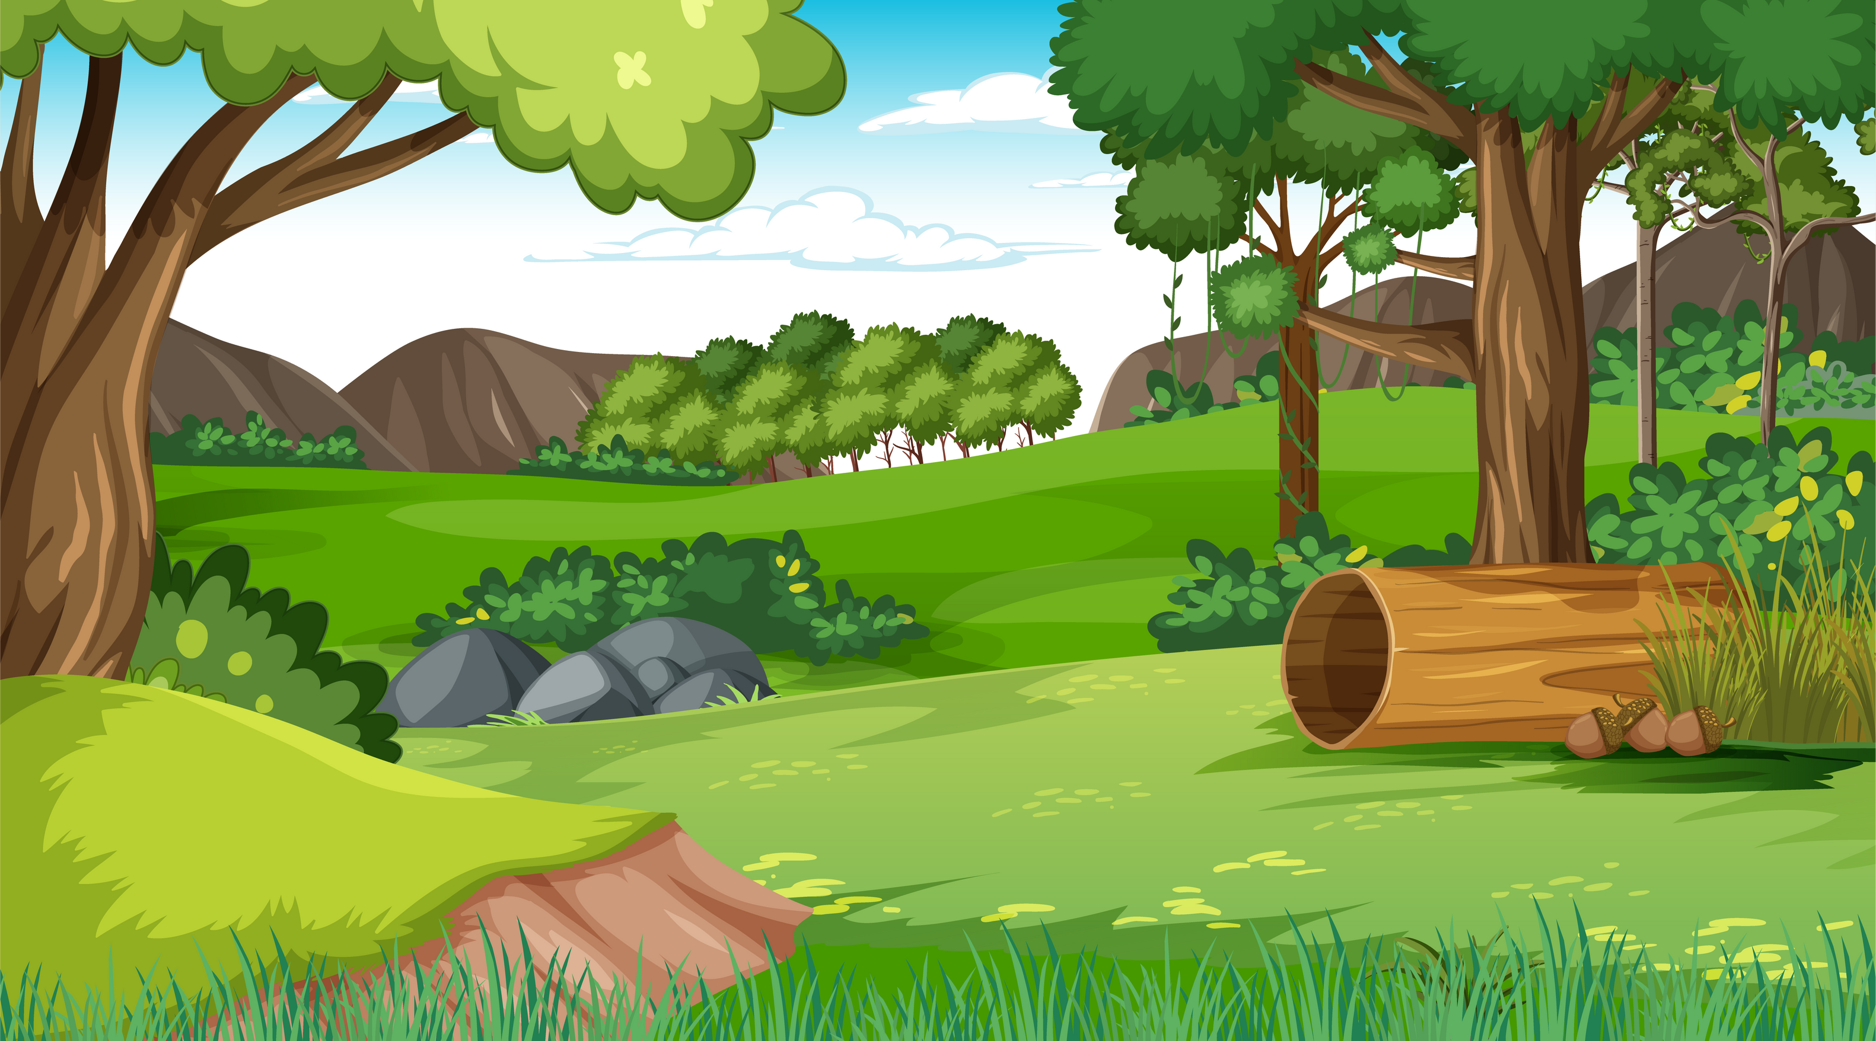



Do you know what a habitat is?
A habitat is a place where plants and animals live.
It's our home and our neighborhood! Let us show you around.

Slide 5
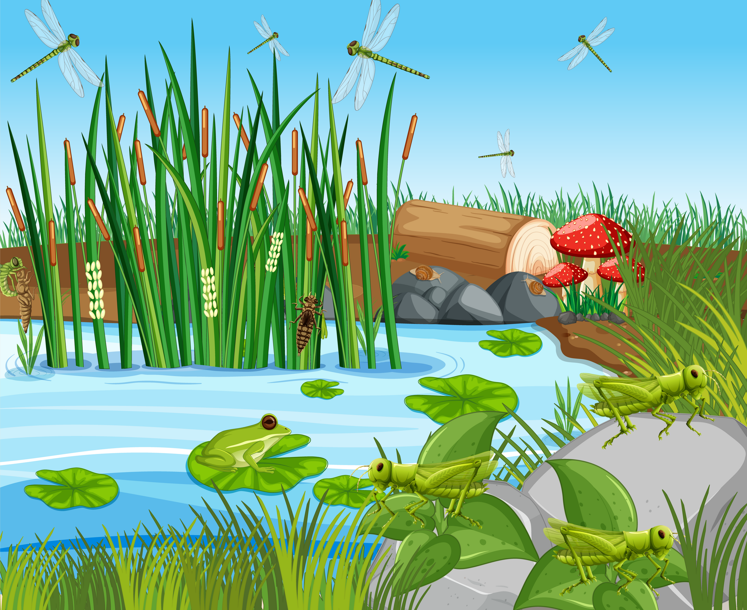


Different habitats have different types of plants and animals that are suited to live in them.
Habitats can be found all around us, both on land and in water.

Slide 6
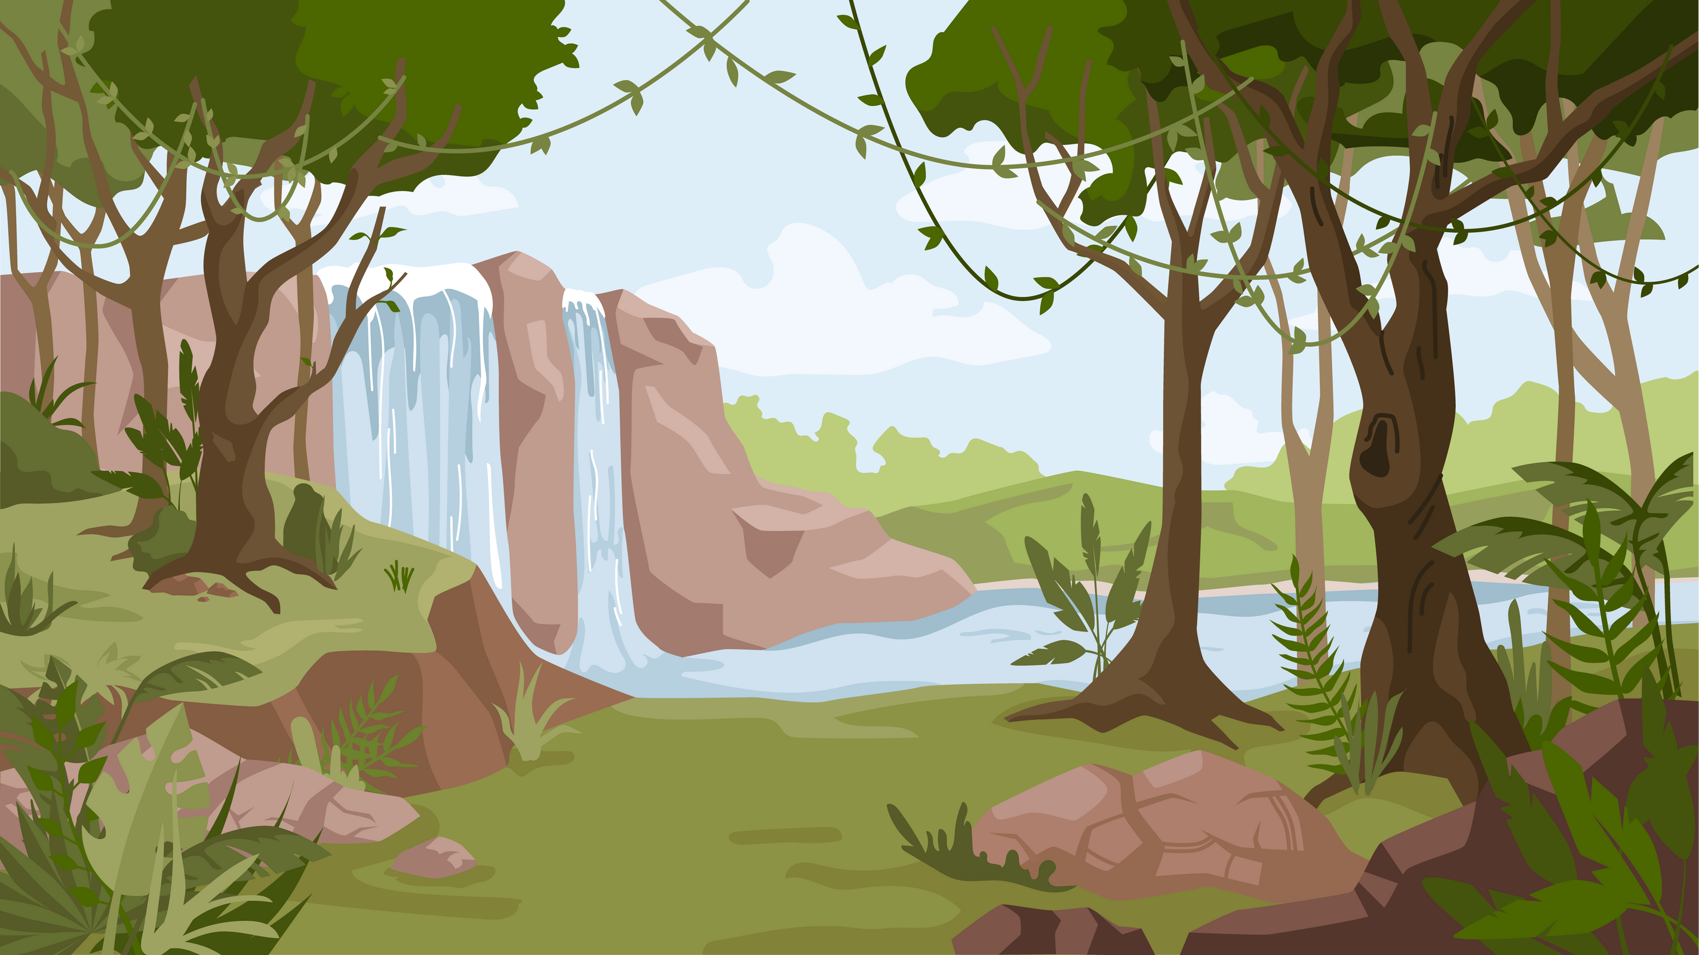


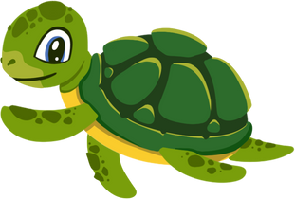
For example, a forest is a habitat with tall trees, birds, squirrels, and other woodland creatures. A pond is a habitat with water plants, fish, frogs, and insects.

Slide 7
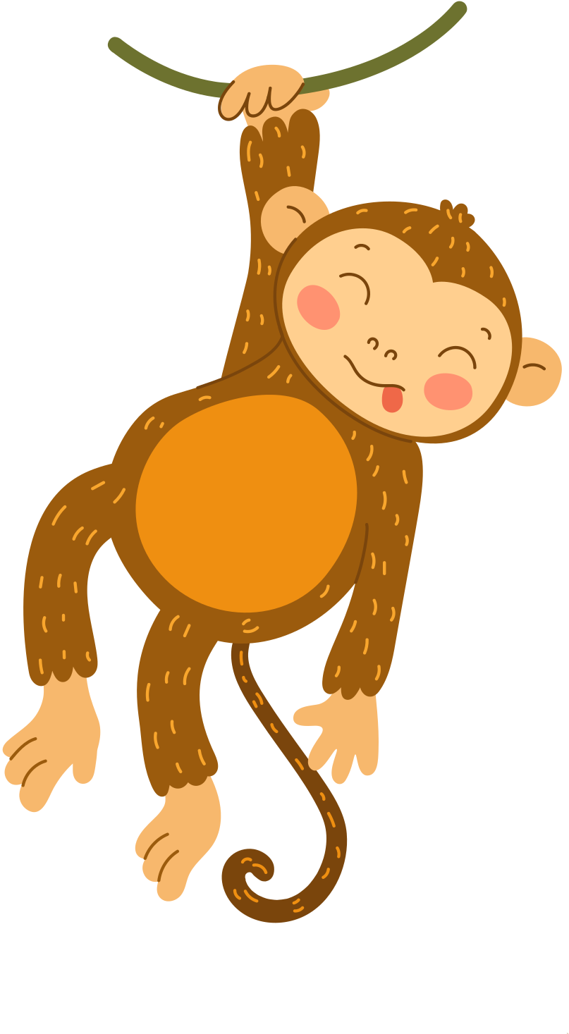
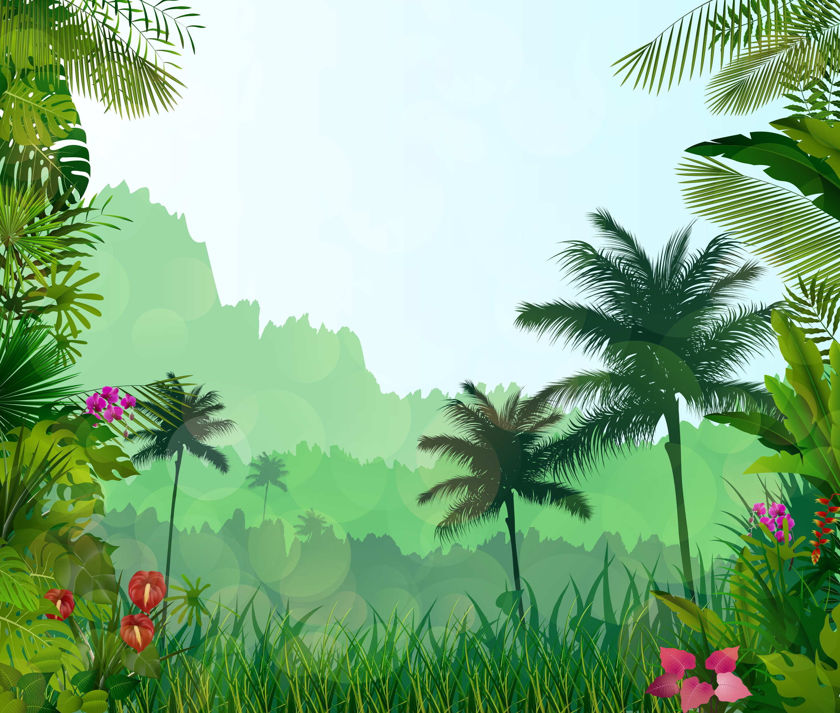

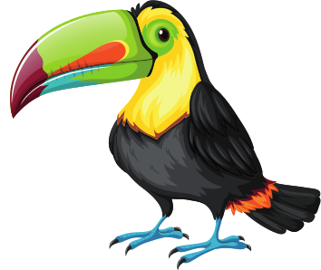

A tropical habitat is a warm and humid environment with lush forests, colorful plants, and a variety of exotic animals, such as monkeys, parrots, and tigers.

Slide 8
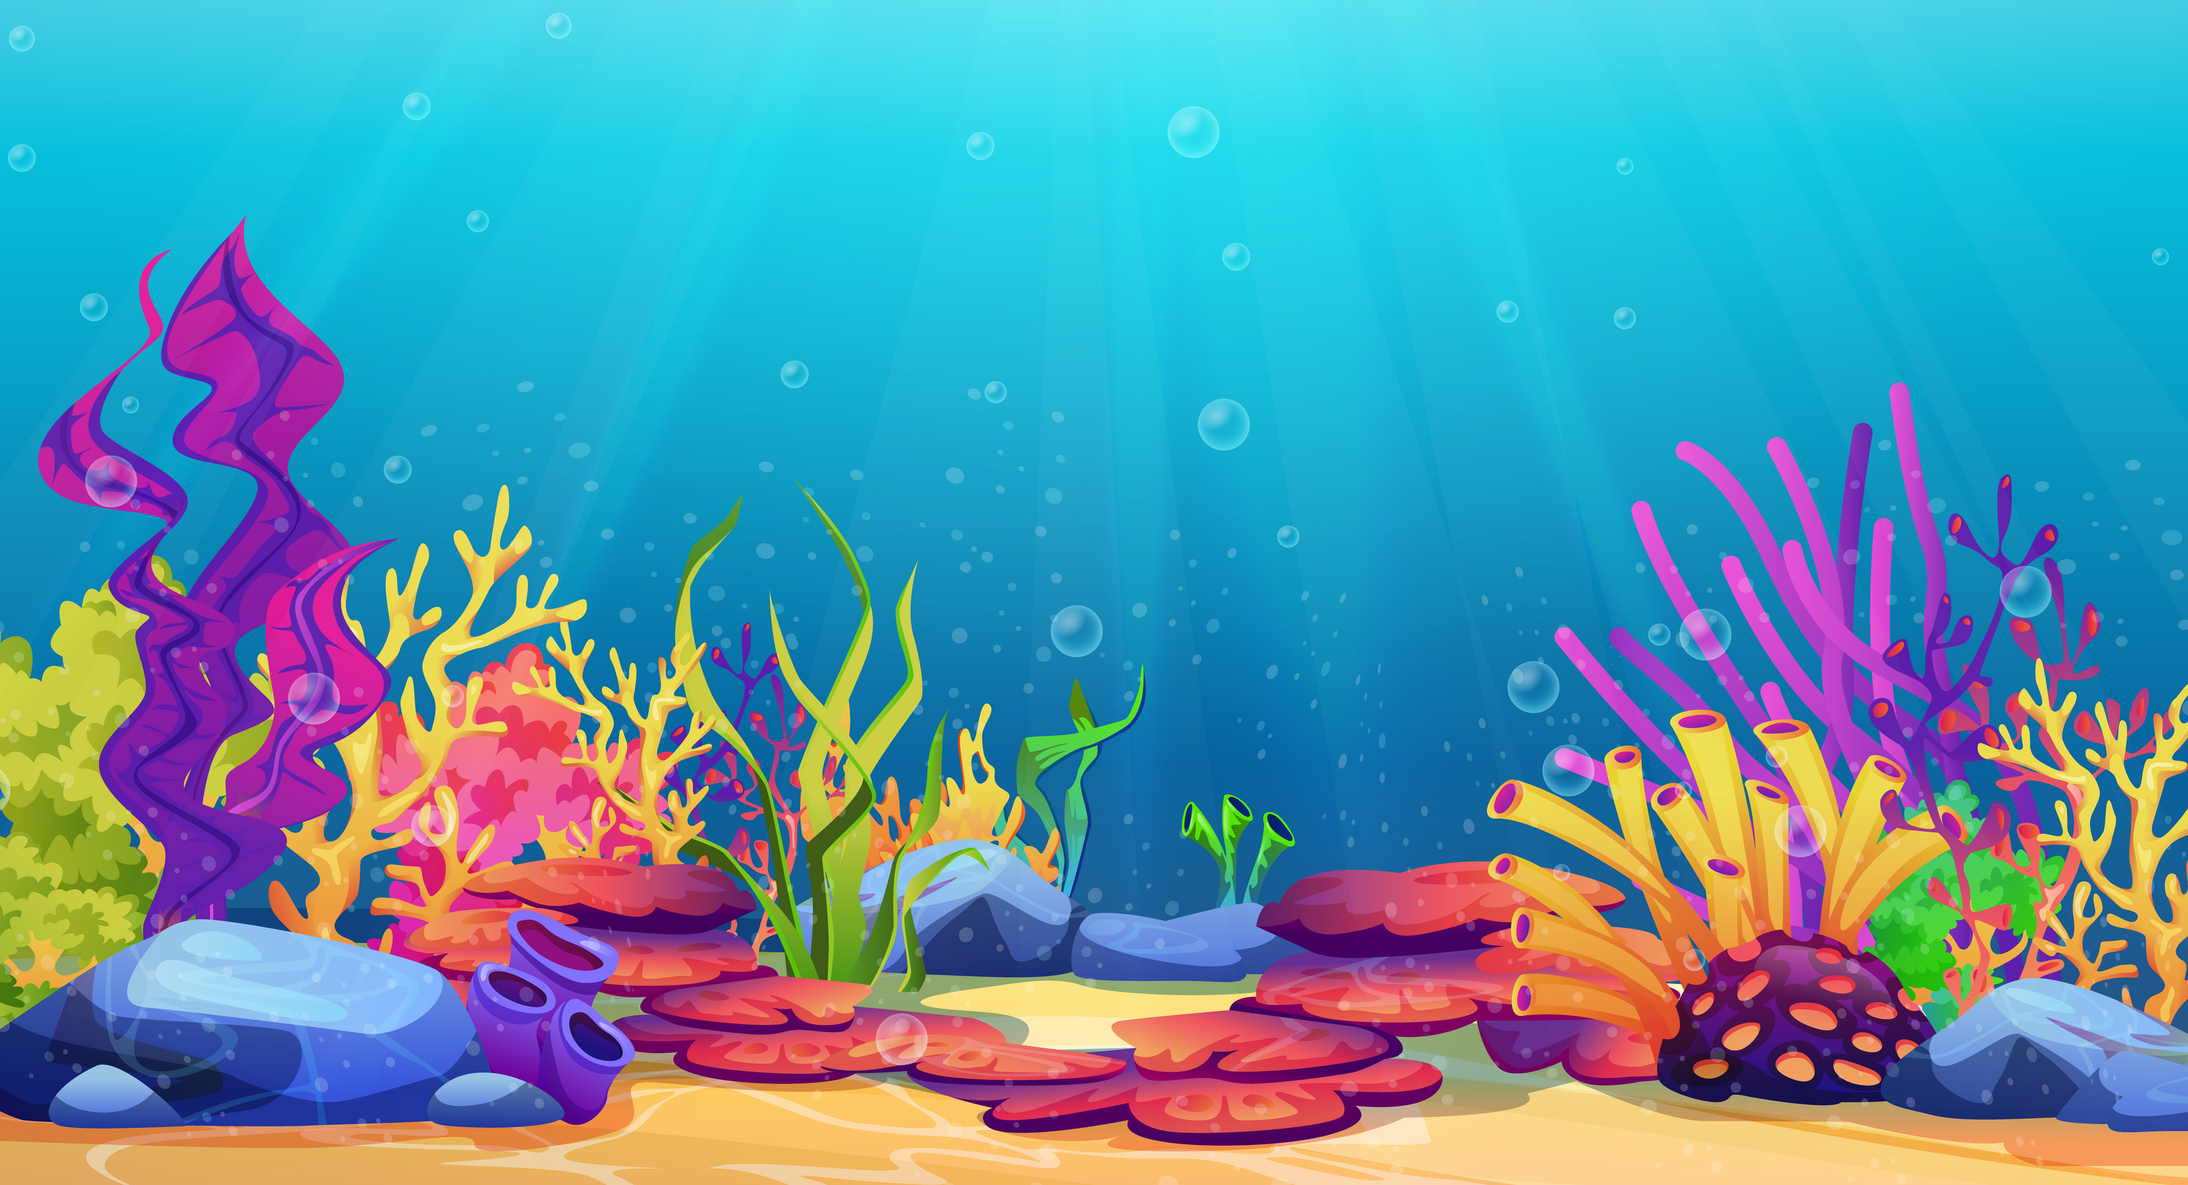
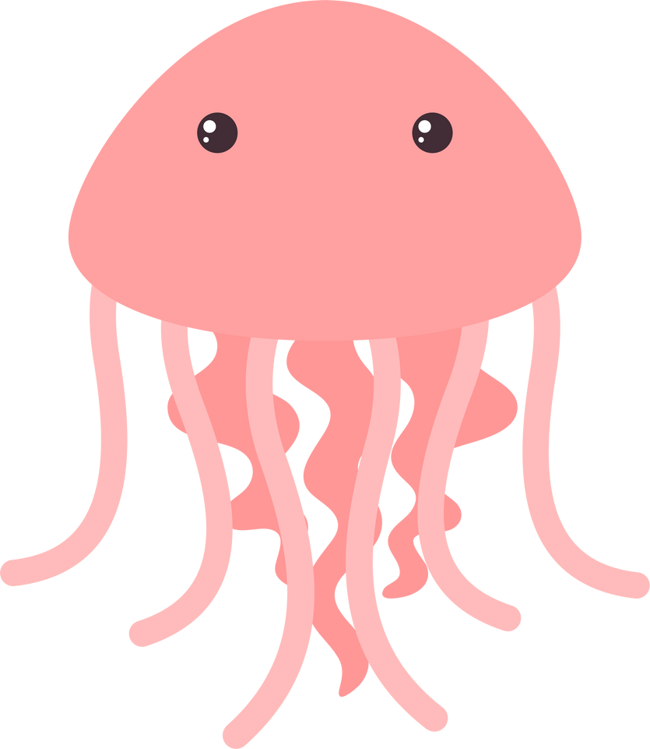
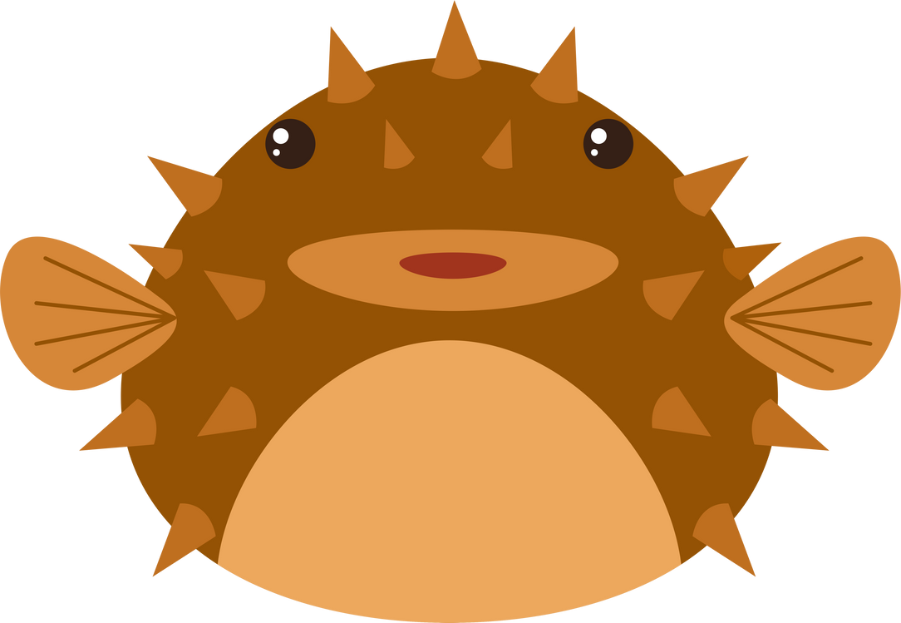

My habitat is the ocean, and I share it with fish, dolphins, whales, seahorses, and many other amazing creatures!

Slide 9



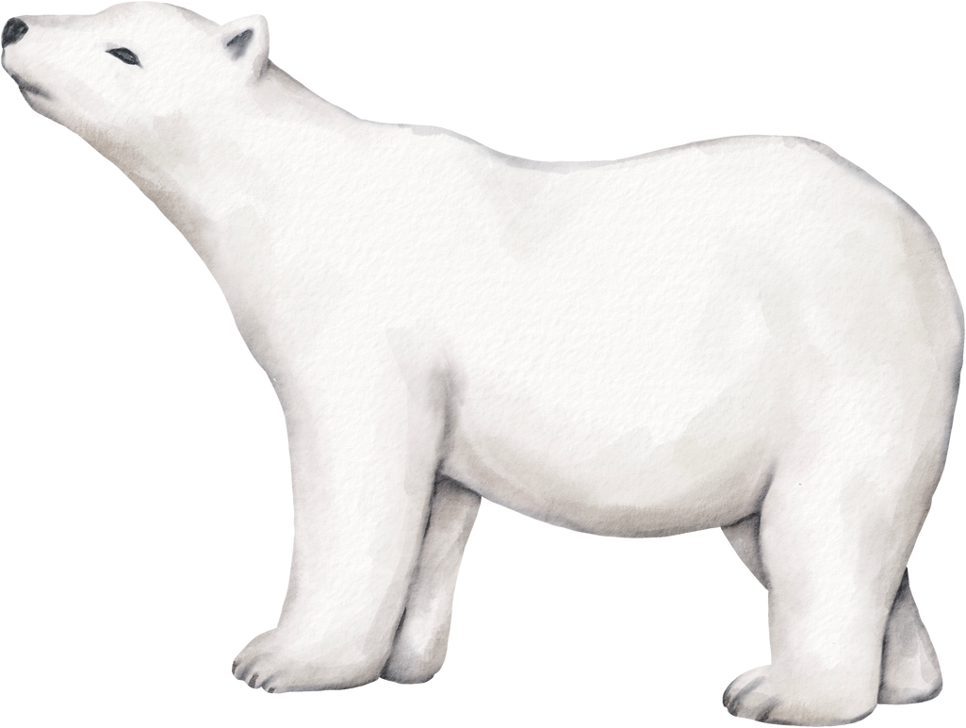

Animals in a habitat have specific adaptations that help them survive in their environment.
For instance, a polar bear has thick fur and a layer of fat to keep warm in the cold Arctic habitat.

Slide 10
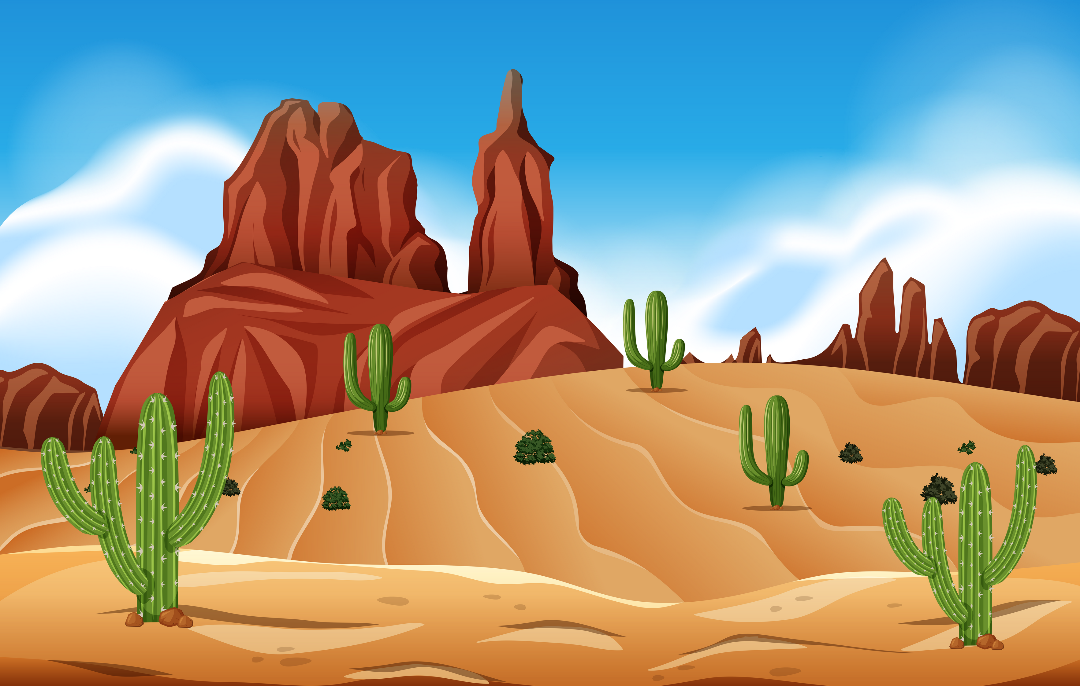
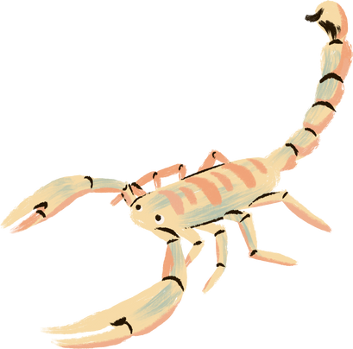

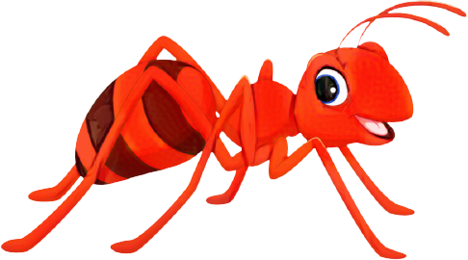
Some animals, like camels and snakes, can go a long time without water, and cacti are plants that can store water in their thick stems.
A desert habitat is a dry and sandy place where very little rain falls, and plants and animals have special adaptations to survive in the extreme heat.

Slide 11
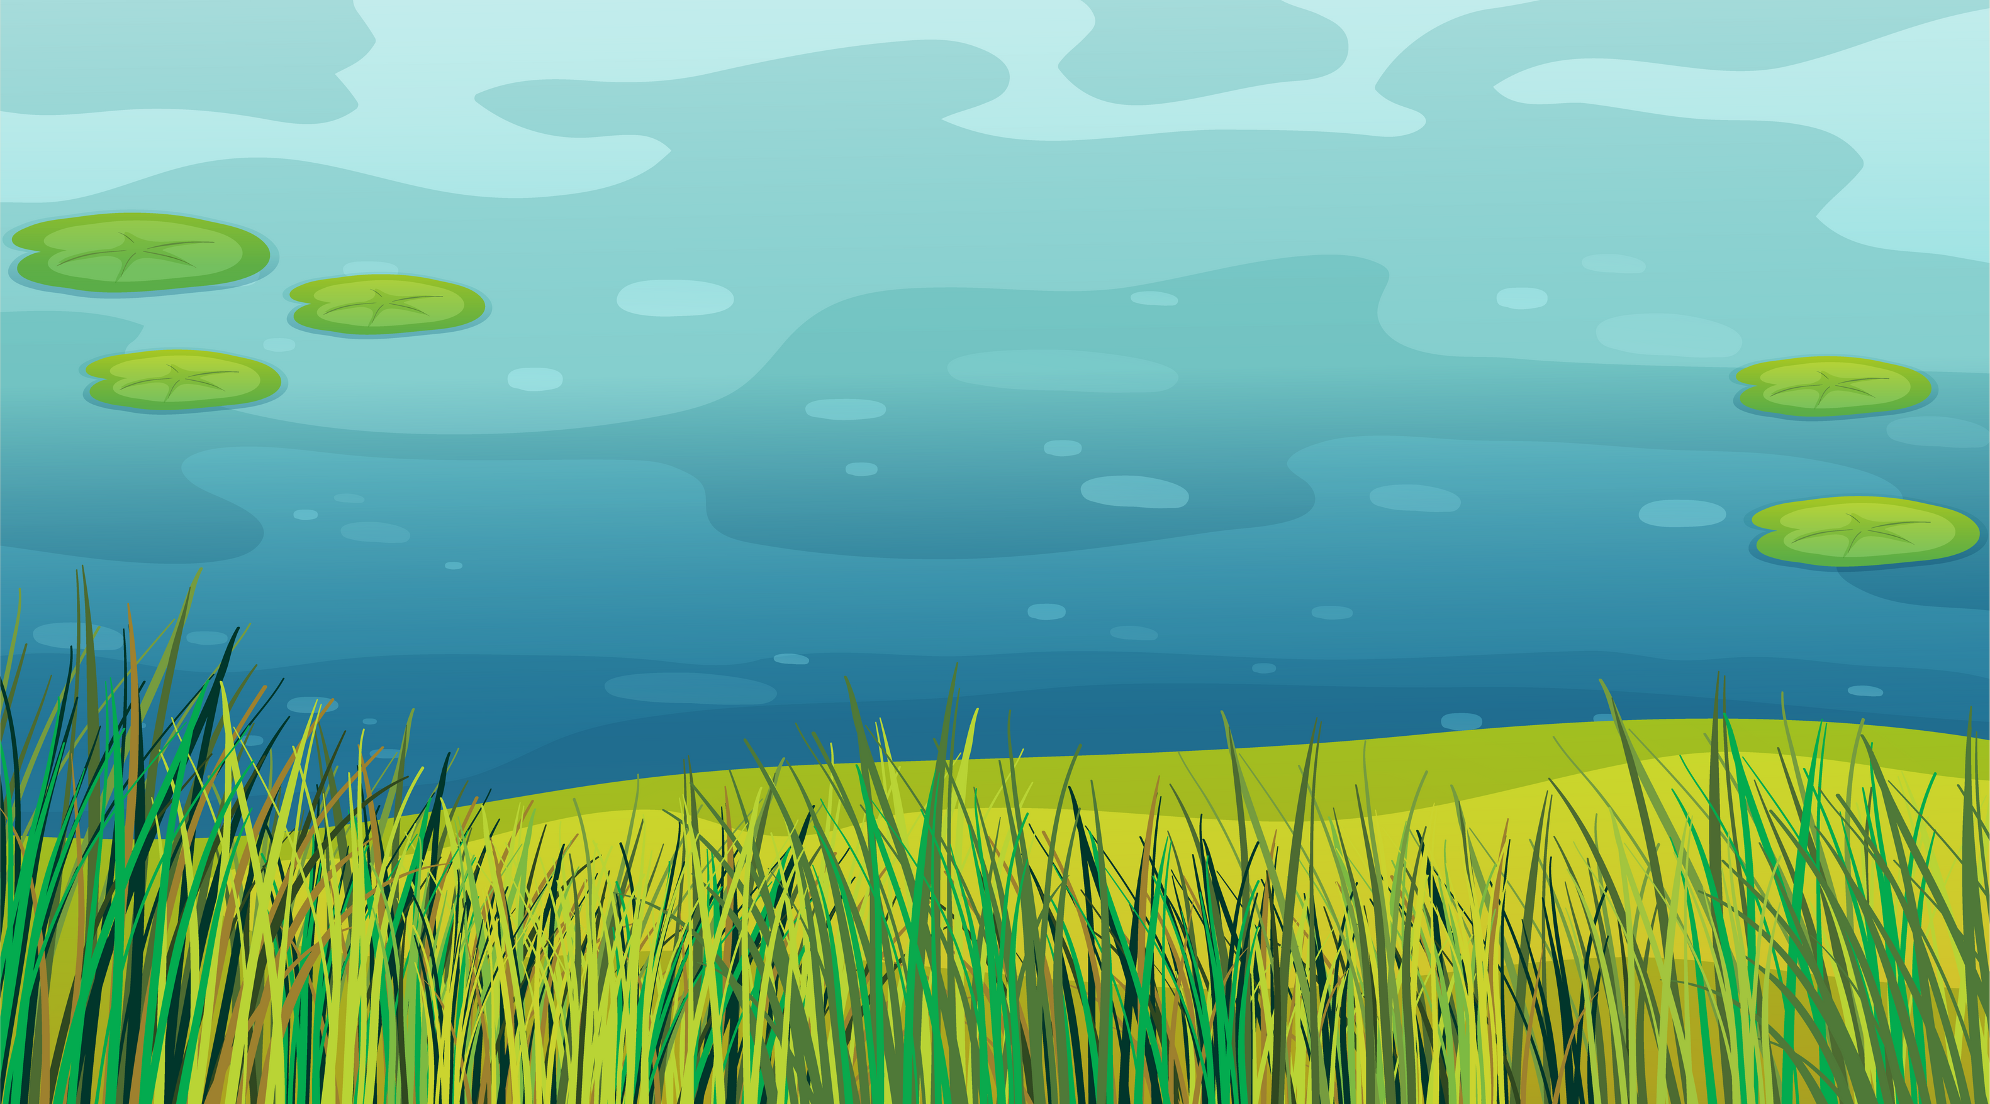

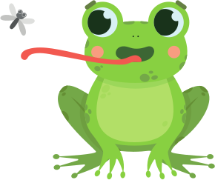



It's important to protect habitats because they are home to many different organisms, and each one plays a role in maintaining the balance of nature.

Slide 12


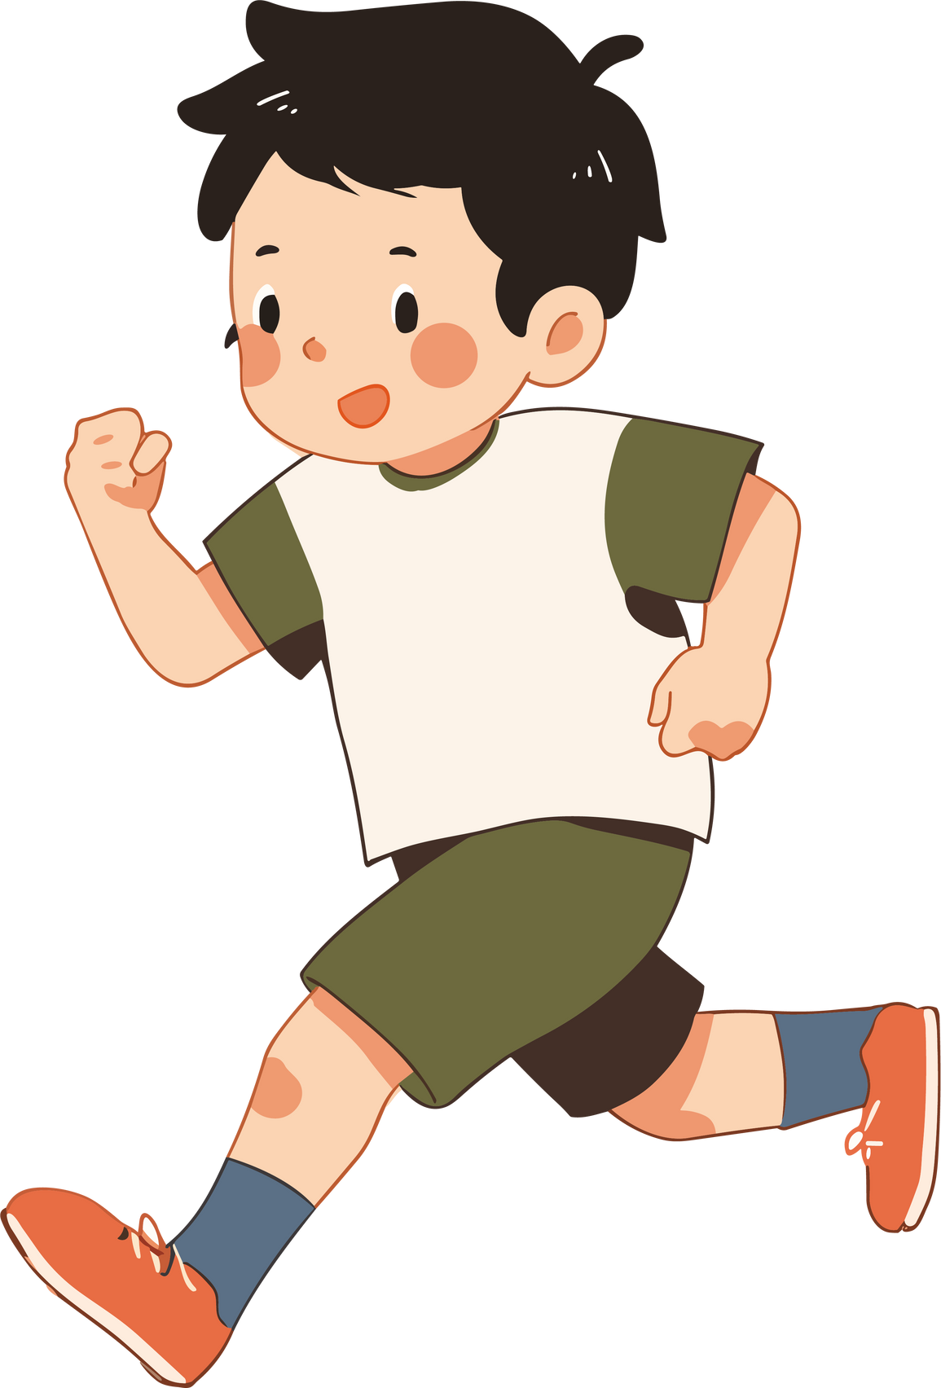
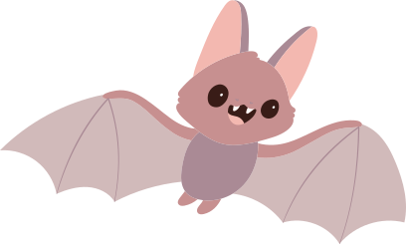
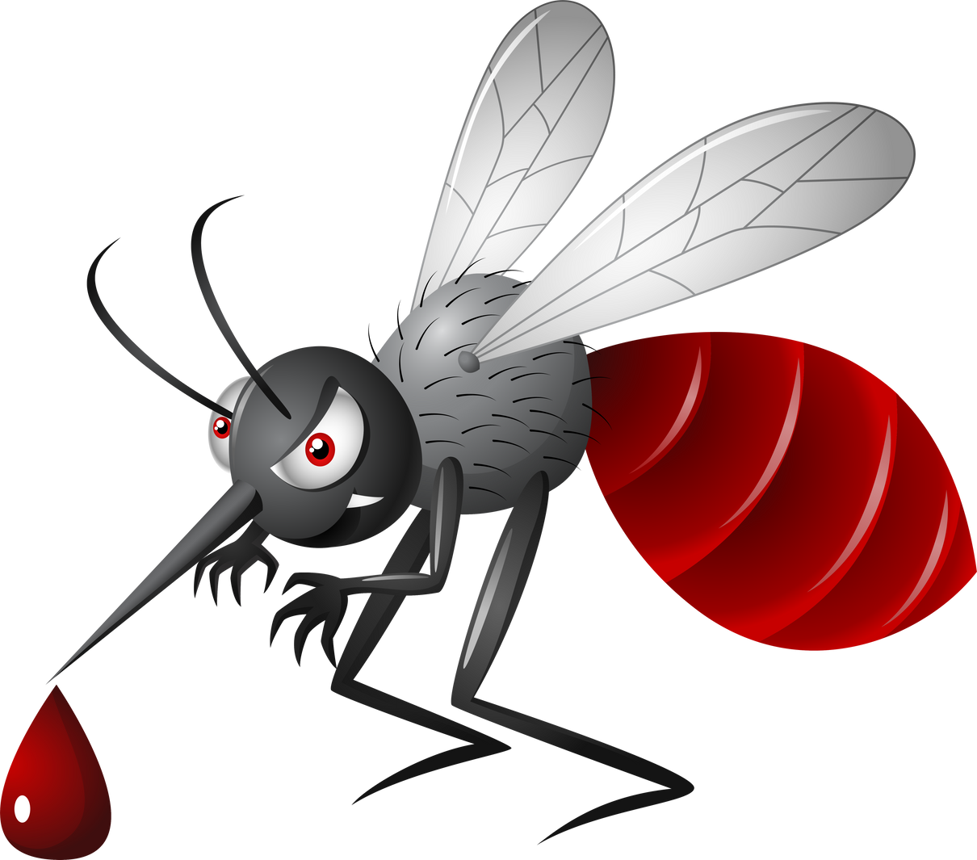

For example:
Sometimes we share a habitat with living creatures we don't live with very well!
But thanks to the ecosystem's food chain, we can have balance!
Mosquito's bite us, but Bats feast on mosquitos and help keep the population down!

Slide 13
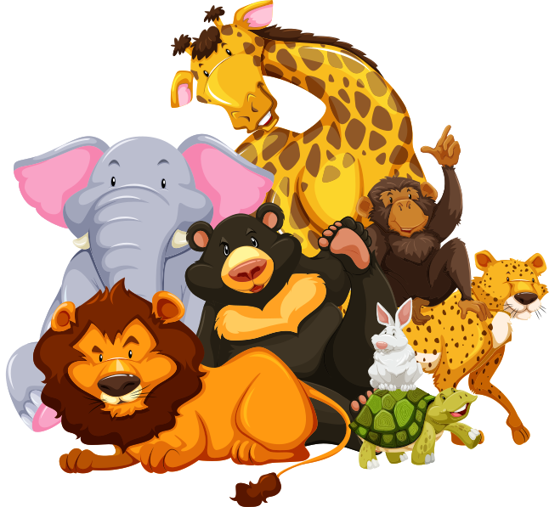
Habitats provide everything living things need to survive.
They offer food, water, shelter, and space to grow and reproduce.

Slide 14




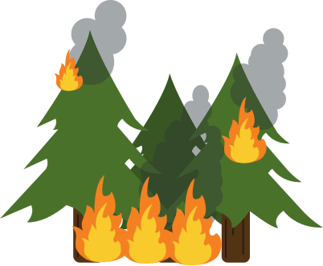
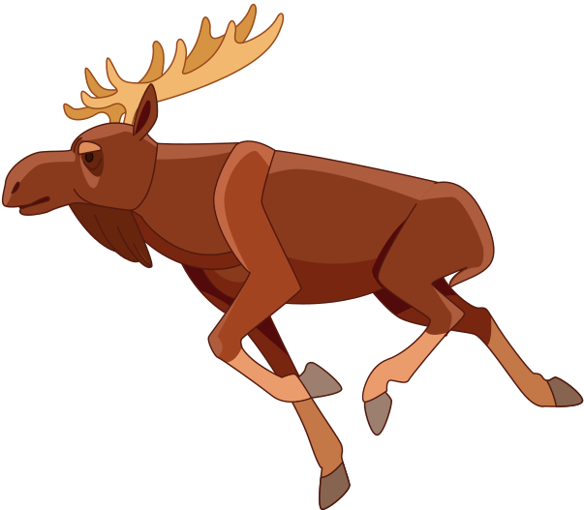

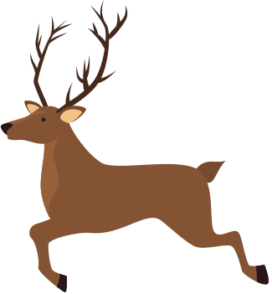
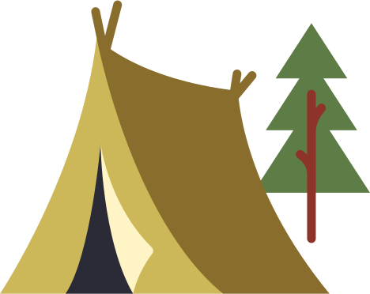
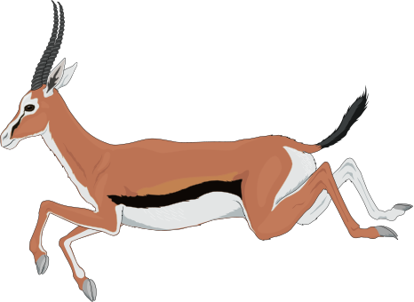




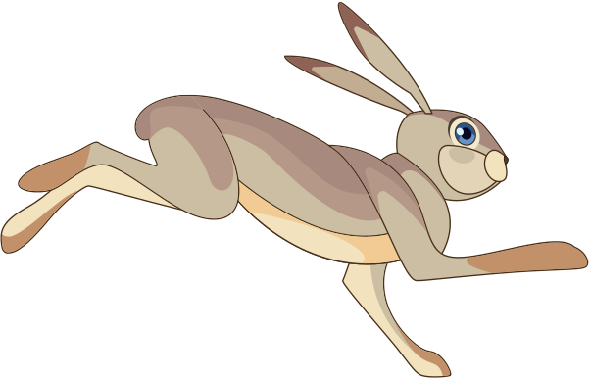
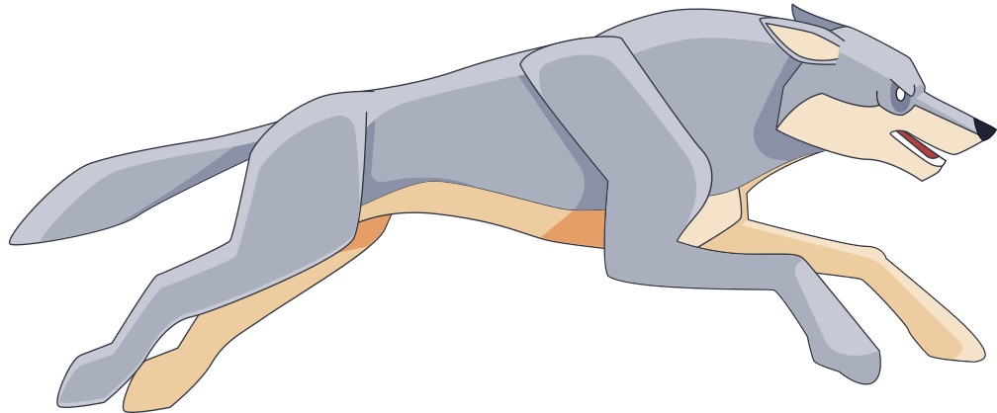


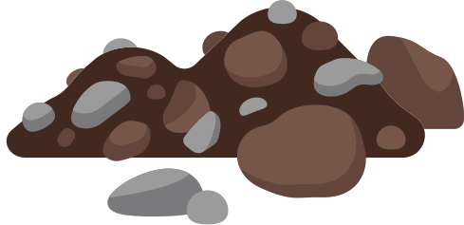
Human activities can sometimes harm habitats, so we need to be mindful of how we interact with the environment and make efforts to preserve and conserve habitats for the benefit of all living things.
Never play with fire!

Slide 15
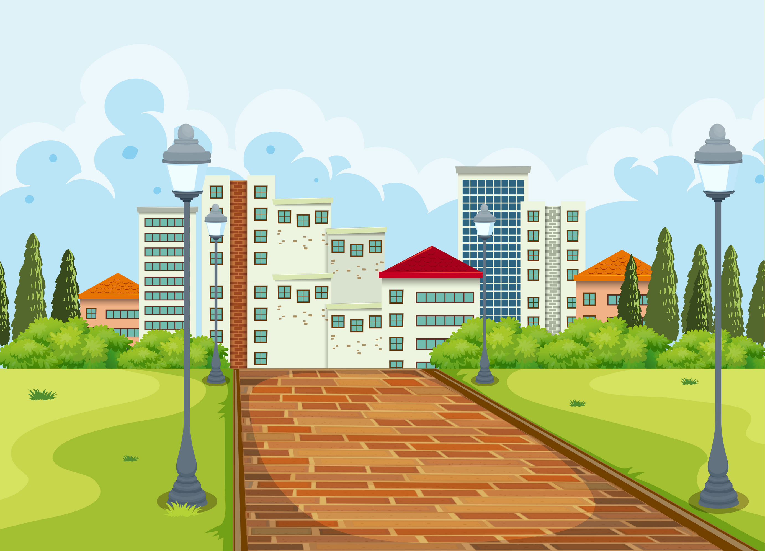


Remember, whether it's the forest, the ocean, rainforest or the desert, or even in a big city, every habitat is unique and full of fascinating plants and animals.
Let's continue exploring and protecting these habitats so that they can be enjoyed by both humans and animals for years to come.

Slide 16

WHOOOOO
HAS QUESTIONS

